Slide 1
Oakwood Presbyterian Church
2020

Slide 2
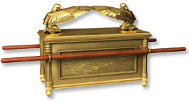
Covenant Theology

Slide 3
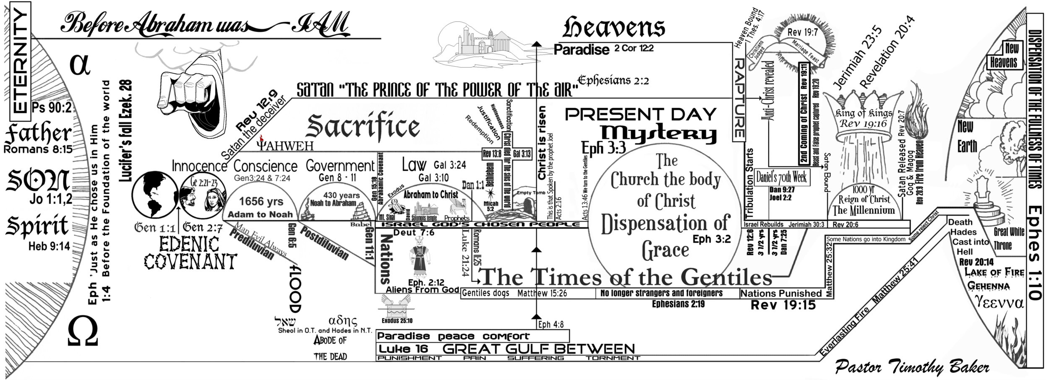
Classical Dispensational Theology
Continuity or Discontinuity?
One people of God or two?
Progressive Dispensationalism, Progressive Covenantalism

Slide 4
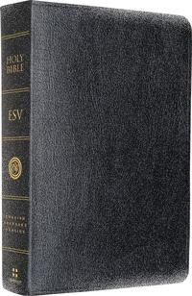
The Structure of Scripture
“So what brings all of these [Biblical] themes together? What unites them is not itself a central dogma but an architectural structure, a matrix of beams and pillars that hold together the structure of Biblical faith and practice. That particular architectural structure that we believe the Scriptures themselves to yield is the covenant. It is not simply the concept of the covenant, but the concrete existence of God’s covenantal dealings in our history that provides the context within which we recognize the unity of Scripture amid its remarkable variety.” Michael Horton

Slide 5
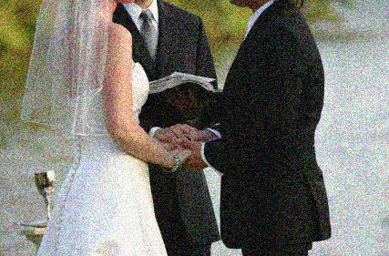
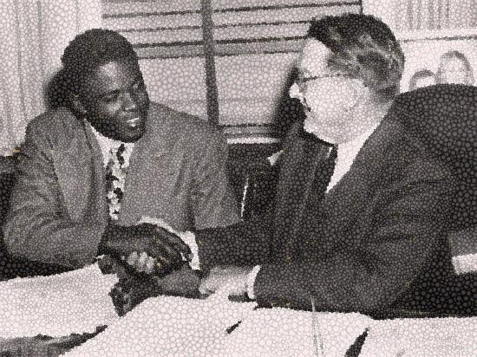
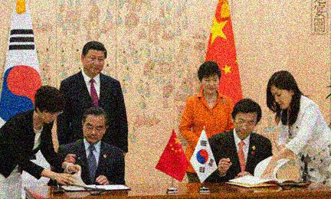
What Is a “Covenant”?
“A covenant is a formal agreement that creates a relationship with legal aspects.”
Michael G. Brown and Zach Keele, Sacred Bond

Slide 6
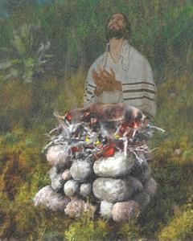
Biblical Covenant Defined
“A covenant is a bond in blood sovereignly administered. When God enters into a covenantal relationship with men, He sovereignly institutes a life-and-death bond… The phrase translated ‘to make a covenant’ in the Old Testament literally reads ‘to cut a covenant’… the dismembered animals represent the curse that the covenant-maker calls down upon himself if he should violate the commitment that he has made.”
O. Palmer Robertson, The Christ of the Covenants

Slide 7
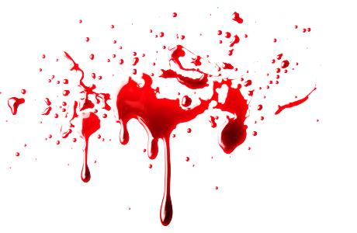
The Blood of the Covenant
“If any one of the house of Israel or of the strangers who sojourn among them eats any blood, I will set my face against that person who eats blood and will cut him off from among his people. For the life of the flesh is in the blood, and I have given it for you on the altar to make atonement for your souls, for it is the blood that makes atonement by the life.” Leviticus 17:10,11
“For when every commandment of the law had been declared by Moses to all the people, he took the blood of calves and goats, with water and scarlet wool and hyssop, and sprinkled both the book itself and all the people, saying, “This is the blood of the covenant that God commanded for you.” …Indeed, under the law almost everything is purified with blood, and without the shedding of blood there is no forgiveness of sins.” Hebrews 9:19-22

Slide 8
The Covenant of Works
Obey & Live
Disobey & Die
“ The Lord God took the man and put him in the garden of Eden to work it and keep it. And the Lord God commanded the man, saying, ‘You may surely eat of every tree of the garden, but of the tree of the knowledge of good and evil you shall not eat, for in the day that you eat of it you shall surely die.’ Genesis 2:15-17
“He will render to each one according to his works: to those who by patience in well-doing seek for glory and honor and immortality, he will give eternal life; but for those who are self-seeking and do not obey the truth, but obey unrighteousness, there will be wrath and fury… For God shows no partiality.” Romans 2:6-11

Slide 9
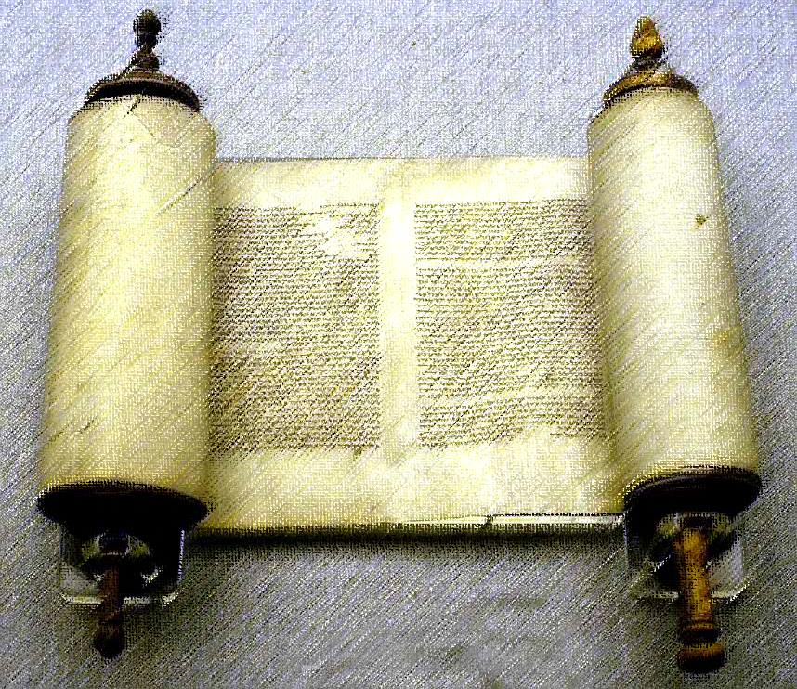
The Covenant of Grace
“And I will establish My covenant between Me and you and your offspring after you throughout their generations for an everlasting covenant, to be God to you and to your offspring after you.” Genesis 17:7

Slide 10
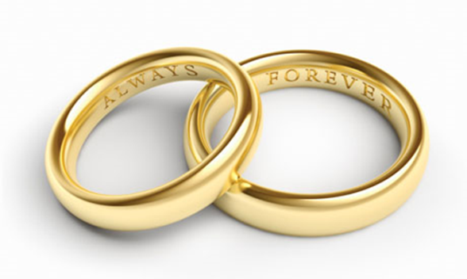
The Central Promise
“I will take you to be My people, and I will be your God.” Exodus 6:7
“…and I will say to Not My People, ‘You are My people’; and he shall say, ‘You are my God.’” Hosea 2:23
“And they shall be My people, and I will be their God, in faithfulness and in righteousness.” Zechariah 8:8
“Behold, the virgin shall conceive and bear a son, and they shall call His name Immanuel [‘God with us’]…” Matthew 1:23
“And I heard a loud voice from the throne saying, ‘Behold, the dwelling place of God is with man. He will dwell with them, and they will be His people, and God Himself will be with them as their God.” Revelation 21:3

Slide 11
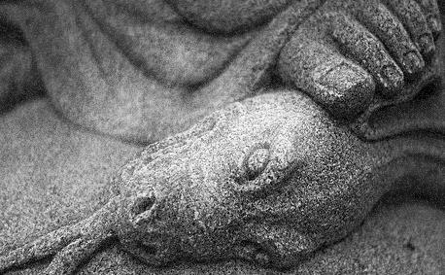
The Adamic Covenant
“I will put enmity between you and the woman, and between your offspring and her offspring; He shall bruise your head, and you shall bruise his heel… And the Lord God made for Adam and for his wife garments of skins and clothed them.” Genesis 3:15,21

Slide 12
The Noahic Covenant
“And God blessed Noah and his sons and said to them, ‘Be fruitful and multiply and fill the earth… But you shall not eat flesh with its life, that is, its blood. And for your lifeblood I will require a reckoning: from every beast I will require it and from man. From his fellow man I will require a reckoning for the life of man. Whoever sheds the blood of man, by man shall his blood be shed, for God made man in his own image… Behold, I establish My covenant with you and your offspring after you, and with every living creature that is with you… I establish My covenant with you, that never again shall all flesh be cut off by the waters of the flood, and never again shall there be a flood to destroy the earth.’ And God said, ‘This is the sign of the covenant that I make between Me and you and every living creature that is with you, for all future generations: I have set My bow in the cloud, and it shall be a sign of the covenant between me and the earth.’” Genesis 9:1-15

Slide 13
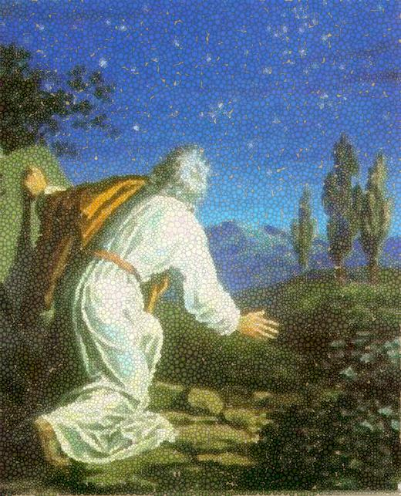
The Abrahamic Covenant
“Now the Lord said to Abram, ‘Go from your country and your kindred and your father's house to the land that I will show you. And I will make of you a great nation, and I will bless you and make your name great, so that you will be a blessing. I will bless those who bless you, and him who dishonors you I will curse, and in you all the families of the earth shall be blessed.’” Genesis 12:1-3

Slide 14
“Cutting” the Covenant
“But [Abraham] said, ‘O Lord God, how am I to know that I shall possess it?’ [God] said to him, ‘Bring me a heifer three years old, a female goat three years old, a ram three years old, a turtledove, and a young pigeon.’ And he brought him all these, cut them in half, and laid each half over against the other… As the sun was going down, a deep sleep fell on Abram. And behold, dreadful and great darkness fell upon him… When the sun had gone down and it was dark, behold, a smoking fire pot and a flaming torch passed between these pieces. On that day the Lord made a covenant with Abram…” Genesis 15:8-18

Slide 15
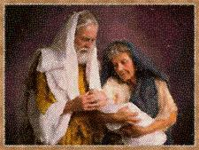
The Signs of the Covenant
”This is My covenant, which you shall keep, between me and you and your offspring after you: Every male among you shall be circumcised. You shall be circumcised in the flesh of your foreskins, and it shall be a sign of the covenant between Me and you… So shall My covenant be in your flesh an everlasting covenant.” Genesis 17:10-13

Slide 16
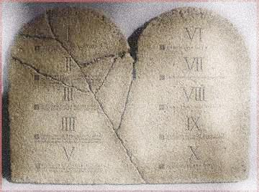
The Mosaic Covenant
“…Moses went up to God. The Lord called to him out of the mountain, saying, ‘Thus you shall say to the house of Jacob, and tell the people of Israel: You yourselves have seen what I did to the Egyptians, and how I bore you on eagles' wings and brought you to Myself. Now therefore, if you will indeed obey My voice and keep My covenant, you shall be My treasured possession among all peoples, for all the earth is mine; and you shall be to Me a kingdom of priests and a holy nation.” Exodus 19:3-6
“And the Lord said to Moses, ‘Write these words, for in accordance with these words I have made a covenant with you and with Israel.’ …And he wrote on the tablets the words of the covenant, the Ten Commandments.” Exodus 34:27,28

Slide 17
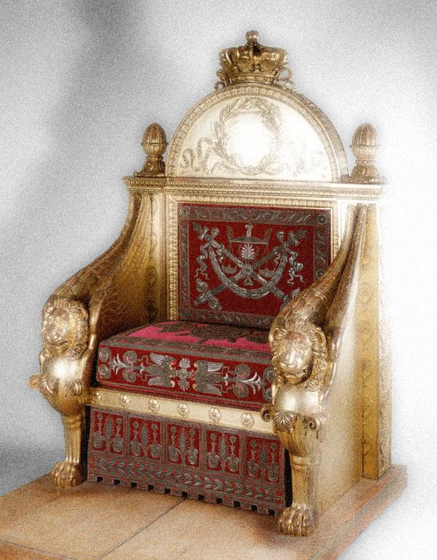
The Davidic Covenant
”Thus says the Lord of hosts, I took you… that you should be prince over my people Israel. And I have been with you wherever you went and have cut off all your enemies from before you. And I will make for you a great name, like the name of the great ones of the earth. And I will appoint a place for my people Israel and will plant them, so that they may dwell in their own place and be disturbed no more… I will raise up your offspring after you, who shall come from your body, and I will establish his kingdom… I will establish the throne of his kingdom forever. I will be to him a father, and he shall be to Me a son… And your house and your kingdom shall be made sure forever before me. Your throne shall be established forever.” II Samuel 7:12-16

Slide 18
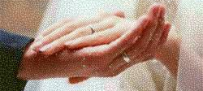
The New Covenant
“Behold, the days are coming, declares the Lord, when I will make a new covenant with the house of Israel and the house of Judah, not like the covenant that I made with their fathers on the day when I took them by the hand to bring them out of the land of Egypt, My covenant that they broke, though I was their husband, declares the Lord. For this is the covenant that I will make with the house of Israel after those days, declares the Lord: I will put My law within them, and I will write it on their hearts. And I will be their God, and they shall be My people. And no longer shall each one teach his neighbor and each his brother, saying, ‘Know the Lord,’ for they shall all know Me, from the least of them to the greatest, declares the Lord. For I will forgive their iniquity, and I will remember their sin no more.” Jeremiah 31:31-34

Slide 19
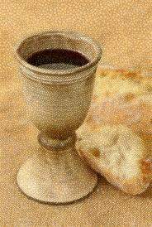
“Immanuel”
“And [Jesus] said to them, ‘I have earnestly desired to eat this Passover with you before I suffer. For I tell you I will not eat it until it is fulfilled in the kingdom of God…’ And He took bread, and when He had given thanks, He broke it and gave it to them, saying, ‘This is My body, which is given for you. Do this in remembrance of Me.’ And likewise the cup after they had eaten, saying, ‘This cup that is poured out for you is the new covenant in My blood.’” Luke 22:15-20

Slide 20
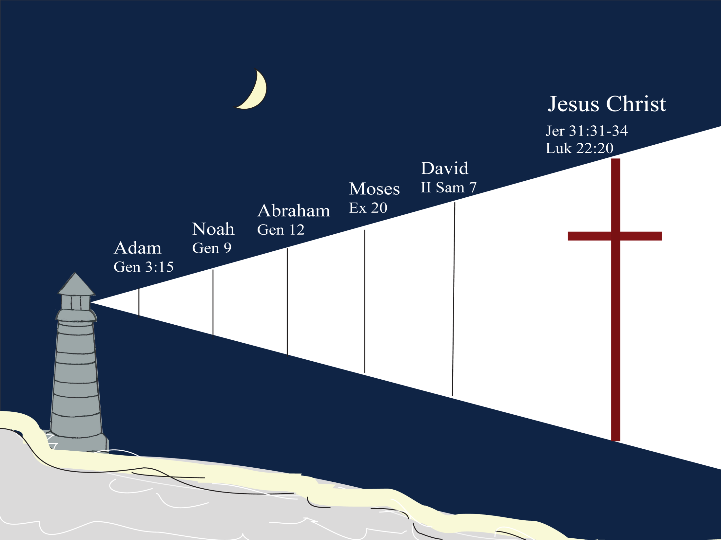

Slide 21
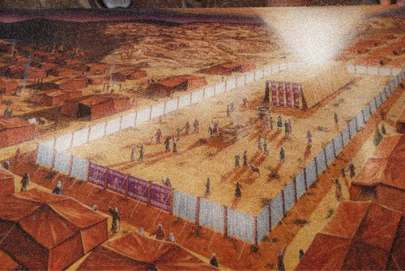
“The reality of God’s residing among His people displays an ever-increasing significance throughout Scripture. It moves from the figure of the tabernacle to the figure of the temple to the figure of the city of God. It involves the incarnate Christ, the Church of Christ, and the final glorification of God’s people. In each case, God’s dwelling among His people is related directly to the heart of the covenant concept: ‘I shall be your God and you shall be My people.’”
O. Palmer Robertson, The Christ of the Covenants

Slide 22
The New Covenant Community
“ Know then that it is those of faith who are the sons of Abraham… in Christ Jesus you are all sons of God, through faith. For as many of you as were baptized into Christ have put on Christ. There is neither Jew nor Greek, there is neither slave nor free, there is no male and female, for you are all one in Christ Jesus. And if you are Christ's, then you are Abraham's offspring, heirs according to promise.” Galatians 3:7, 26-29
“But you are a chosen race, a royal priesthood, a holy nation, a people for His own possession, that you may proclaim the excellencies of Him who called you out of darkness into His marvelous light. Once you were not a people, but now you are God's people; once you had not received mercy, but now you have received mercy.” I Peter 2:9,10

Slide 23
The Covenant Fulfilled
“Then the angel showed me the river of the water of life, bright as crystal, flowing from the throne of God and of the Lamb through the middle of the street of the city; also, on either side of the river, the tree of life with its twelve kinds of fruit, yielding its fruit each month. The leaves of the tree were for the healing of the nations. No longer will there be anything accursed, but the throne of God and of the Lamb will be in it, and his servants will worship him. They will see His face, and His name will be on their foreheads. And night will be no more. They will need no light of lamp or sun, for the Lord God will be their light, and they will reign forever and ever.” Revelation 22:1-5

