Slide 1
Ulrich zwingli and the reformation in Switzerland

Slide 2
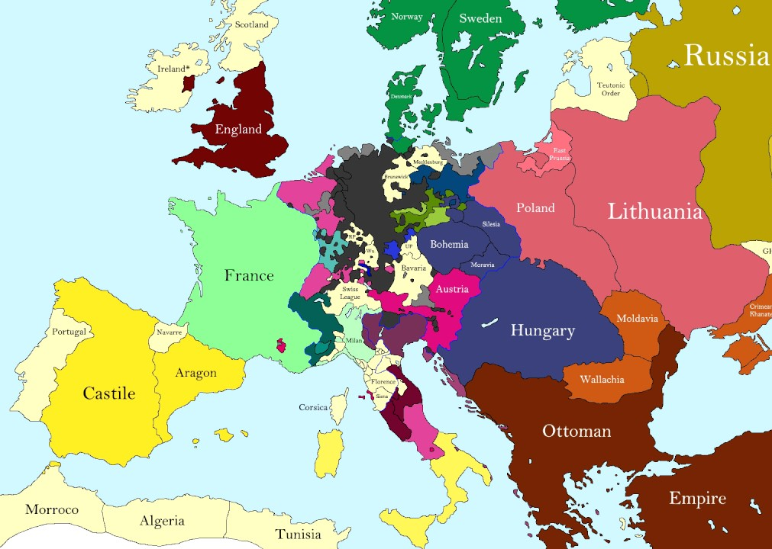
The Swiss Confederation

Slide 3
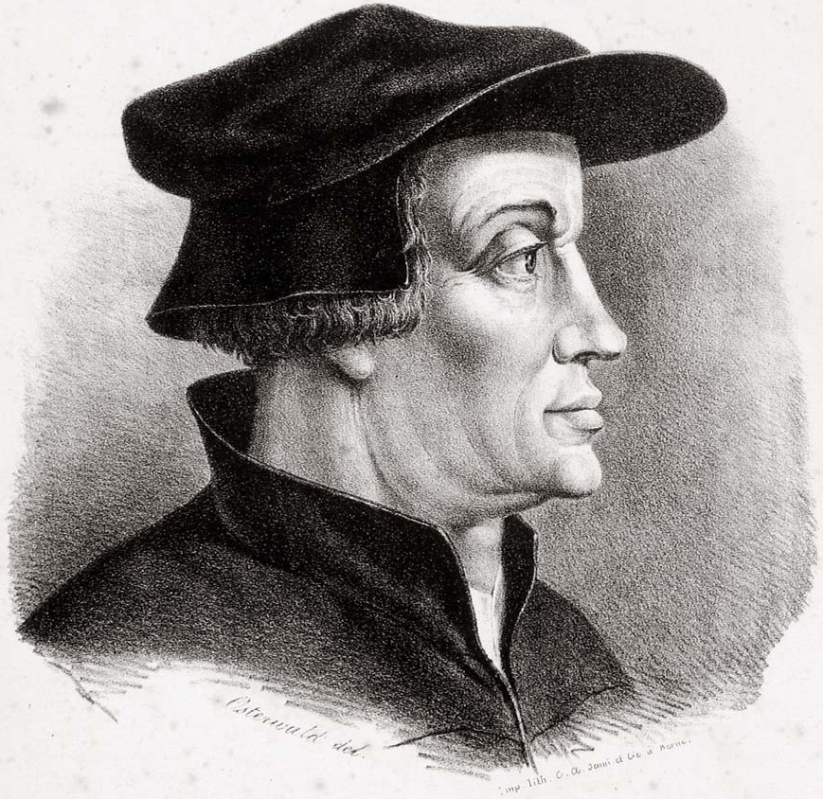
Ulrich Zwingli
Born in 1484 (3 months after Martin Luther)
Became a parish priest at age 22; became a chaplain for the papal army
1516 – begins studying Erasmus’ translation of the Greek New Testament
1518 – becomes preacher at large church in Zurich
Announces that he will preach through Matthew
1519 – nearly died of the plague

Slide 4
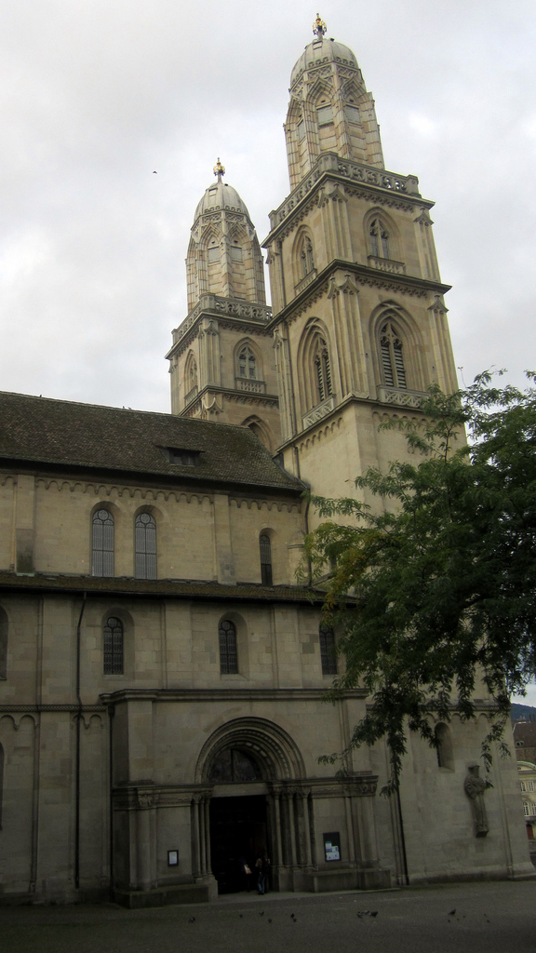
Reformation in Zurich
Zwingli was more cautious than Luther
Agreed that reform must come by the Word of God changing hearts, not force
The pope relied on mercenary soldiers from Switzerland
1522 – 67 Theses – covered most areas of Reformation theology and practice
1523 – Zwingli wins debate with opponents; begins training preachers

Slide 5
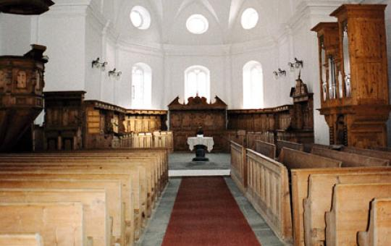
Zwinglian Reforms
Similar to Lutheran reforms, except in regard to worship
Strict regulative principle – nothing except what is commanded by Scripture
Plain buildings – no pictures, statues, etc.
At first, only Bible reading, prayer, and preaching; later Psalm singing is added (without instruments)

Slide 6
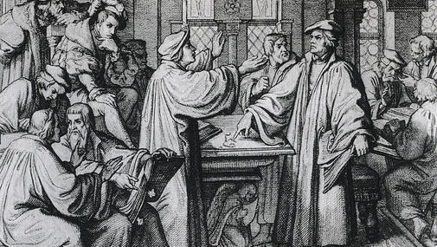
Marburg Colloquy
Called by Phillip of Hesse to unify the Protestants (Zwinglian and Lutheran)
Different views of the Lord’s Supper
Catholic – transubstantiation
Lutheran – consubstantiation
Zwinglian – memorial / spiritual presence
Luther – “This is My body” – no compromise

Slide 7
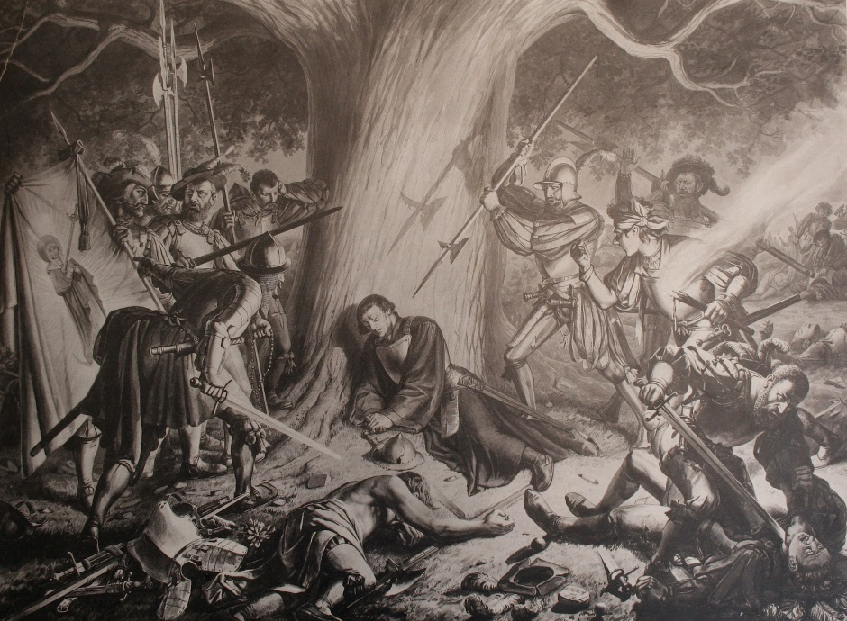
Division in the Swiss Confederation
1531 – five Catholic cantons attack Zurich; Zwingli leads Zurich armies
Armies of Zurich slaughtered; Zwingli killed
One month later – Peace of Kappel is signed – each canton to chose its own religion
Henry Bullinger takes Zwingli’s position
Writes 1st and 2nd Helvedic Confessions

Slide 8
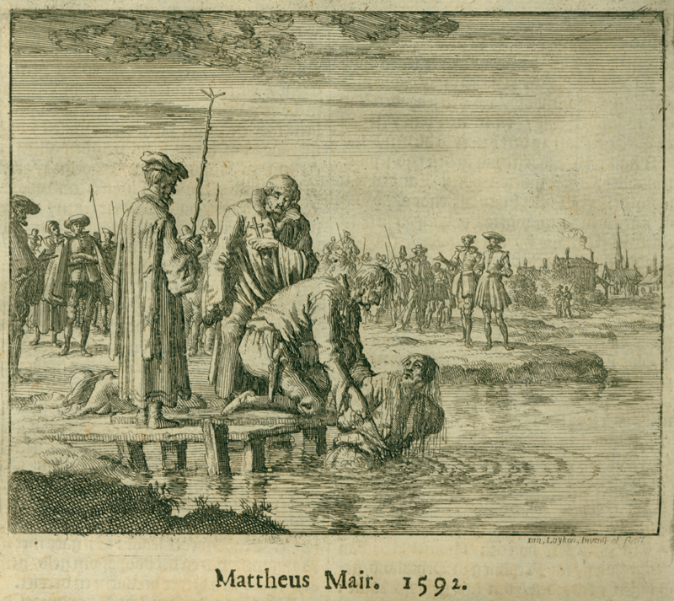
The Anabaptists
A loose and varied movement to “reform the Reformation”
“Ana-baptists” – “re-baptizers”
Common teachings:
Adult baptism – reaction to state churches
Separation from the world – no cooperation with the state; stand apart from culture; communal living; no private property
Pacifism – no resistance to force; no service in military; paid no taxes for military
Individualism – emphasis on individual decision in salvation and in theology; aversion to creeds

Slide 9
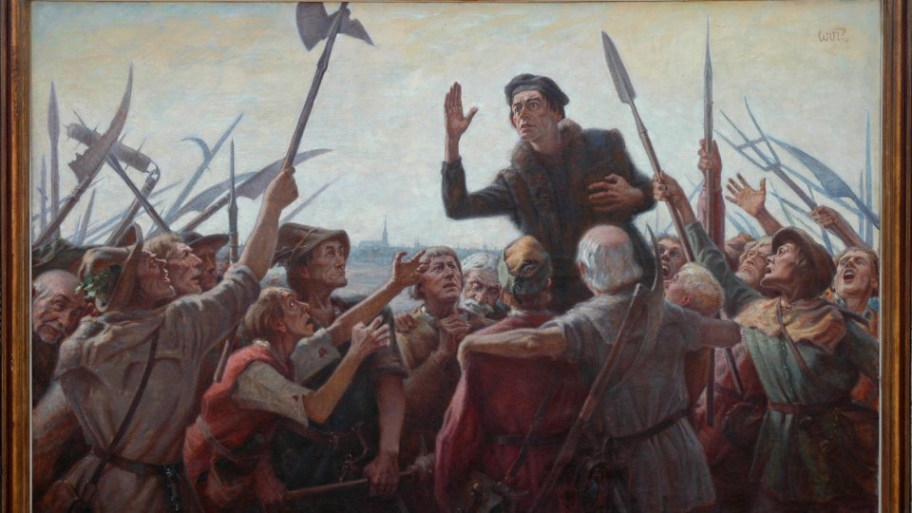
Thomas Muntzer
A contemporary of Luther; started as a Lutheran, but became Anabaptist
A fiery, apocalyptic preacher
Said “inner word” was superior to the “outer word” (Bible)
Unlike other Anabaptists, he advocated taking up the sword to usher in End Times
Captured, tortured, & beheaded during The Peasant Wars in Germany

Slide 10
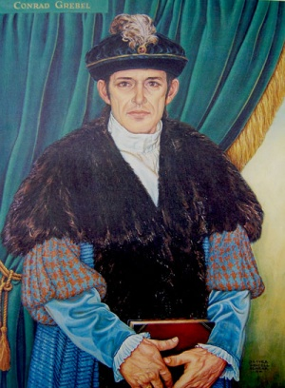
Conrad Grebel
Leader of Anabaptists in Zurich
1525 – loses a disputation with Zwingli and Bullinger
City council requires all children to be baptized
Grebel and other leaders baptize adults and offer the Lord’s Supper – break with the Lutheran church
Catholic church, most of Lutheran states, and city of Zurich all condemn Anabaptists to death (often by drowning)

Slide 11
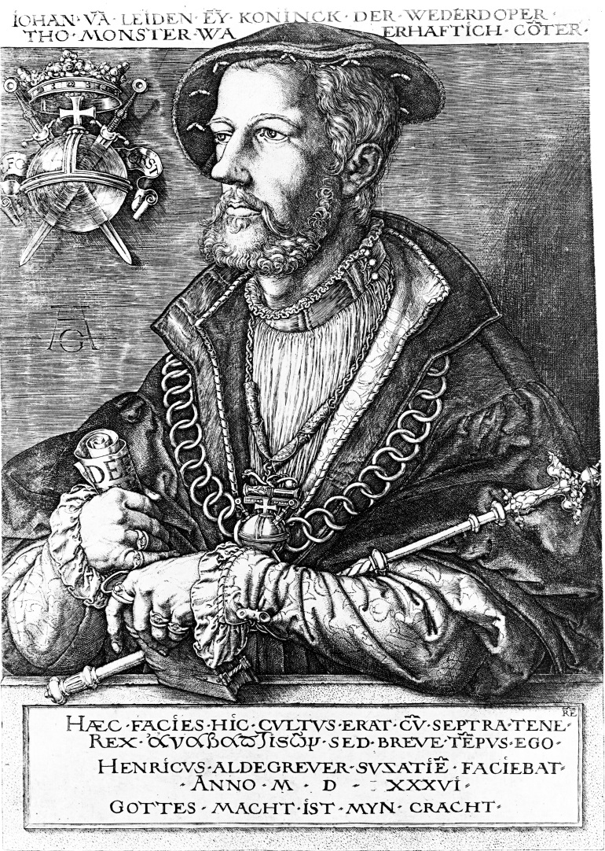
Munster
1534 - city in NW Germany that comes under control of Anabaptists – “The New Jerusalem”, where Armageddon would begin
All who refuse adult baptism forced to leave
Jan van Leiden – has himself anointed as “King David”
Allows polygamy and enforces communal property
Death penalty for refusing adult baptism and trivial offenses
1535 – combined Catholic-Lutheran army lays siege and is let in by disgruntled citizens

Slide 12
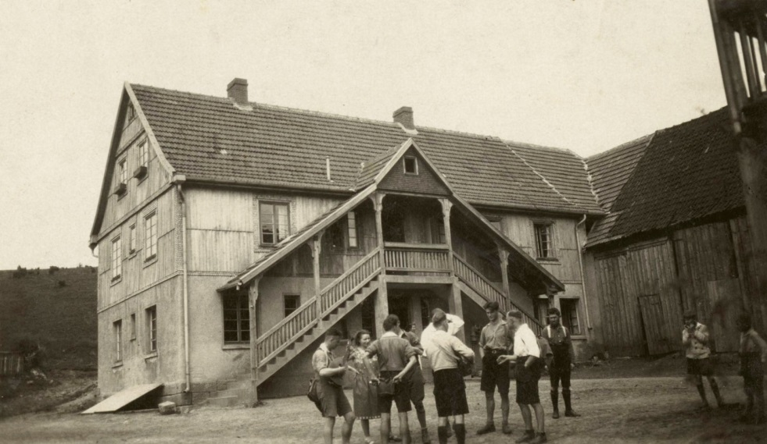
Hutterites
Moravia gives toleration to Anabaptists
Jakob Hutter – led the formation of “Bruderhofs” (“brother-houses”) – total communal living in multiple buildings
“In the time of peace between 1564 and 1619 the Hutterites of Moravia became celebrated, for they could manufacture the best objects at a lower price than was possible elsewhere.” Owen Chadwick
Confession of Schleitheim – practical issues, little theology

Slide 13
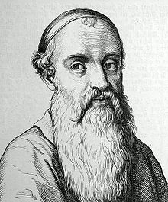
Mennonites
Menno Simons - born in 1496 in Holland; became a Catholic priest
Drawn to Anabaptist teaching, but his brother died in massacre at Munster
Wrote “The Blasphemy of Jan van Leiden”
“The Calvin of the Anabaptist Movement”
Emphasis on separation, simplicity, pacificism
Community-oriented, but not communal

