Slide 1
The spread of reformed protestantism in europe

Slide 2
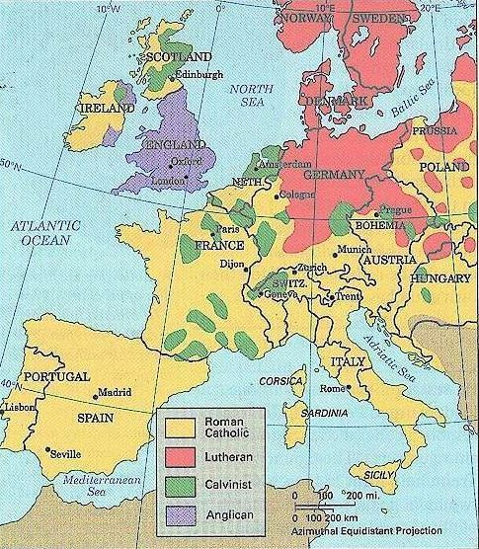

Slide 3
“[Reformed Churches] made their conquests mainly in the countries where the government was Catholic and hostile. The most conservative reformations were in those countries where the government sooner or later took charge of the Reformation and blessed it – the north German principalities, Denmark, Sweden, England. The least conservative reformations were in those countries where the government resisted by force, and where the religious revolution required a political revolution also – France, the Netherlands, Scotland. The more hostile the state, the more likely that the Protestants would be Calvinist, for Calvinism established an authority of the ministry free from spiritual subjection to the state authorities.”
Owen Chadwick, The Reformation

Slide 4
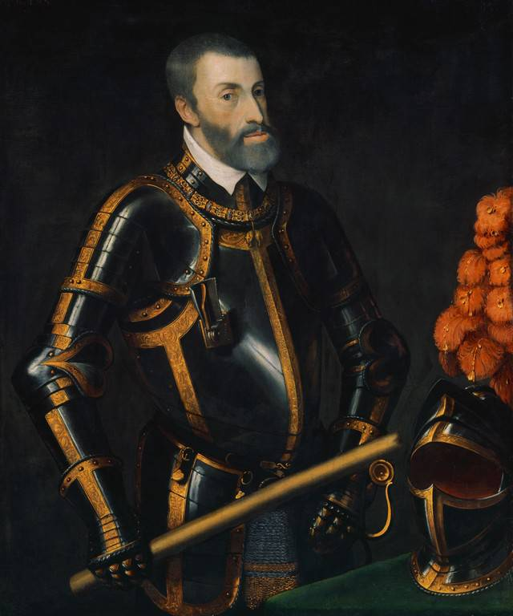
Reformed Churches in Germany
After Luther’s death, Holy Roman Emperor Charles V seeks to stamp out the Protestant movement
1547 – defeats Saxony and imprisons Elector Frederick and Philip of Hesse
Augsburg Interim – 1548 – takes away most rights of Lutherans
But the people resist and the Emperor’s attempts to restore Catholicism mostly fail
Emperor Charles V

Slide 5
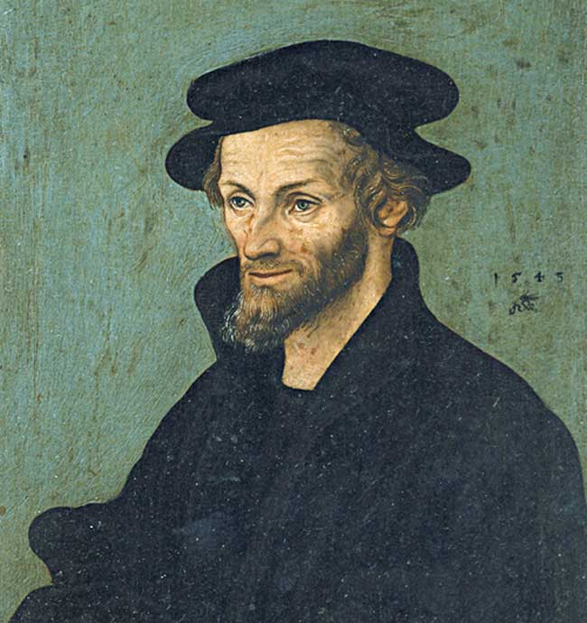
Division Among the Lutherans
Philip Melanchthon stays at Wittenberg & compromises by accepting Catholic rituals and leaders, in return for the ability to continue teaching Protestant doctrine
“Philippists” vs. “Rigorists”
Rigorists – Catholics were nearer to orthodoxy than Calvinists
The Peace of Augsburg – 1555 – Emperor allows each state to choose – Catholic or Lutheran
The Heidelberg Catechism – 1563 – Reformed doctrine - written to counter Catholicism and Rigorists
The Formula of Concord – 1577 – rejected Reformed view of the sacraments and Reformed doctrines
many Philippist churches become Reformed
Philip Melanchthon

Slide 6
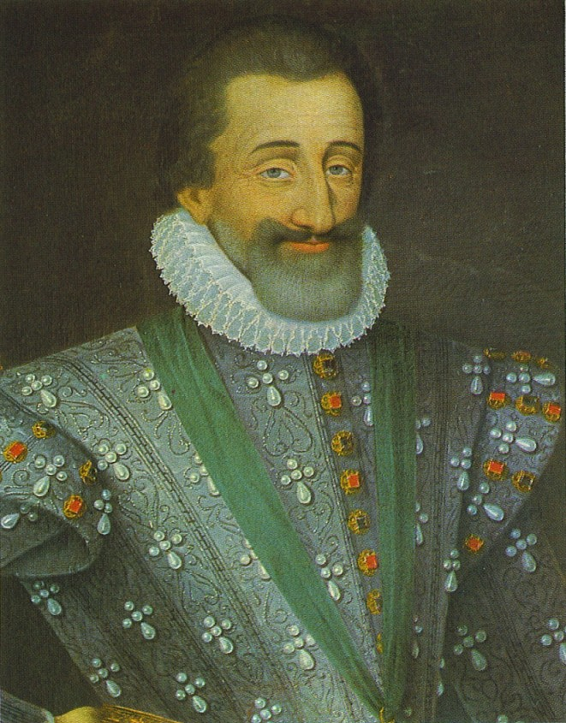
Reformed Churches in France
John Calvin and Theodore Beza lead this movement from Geneva
Struggle for the French throne – between the House of Guise (Catholic) and the House of Bourbon (Protestant)
Sanctuaries for Protestants (Huguenots):
Navarre in the south – King Henry & Queen Margaret
Normandy in the north – Admiral Coligny
King Henry of Navarre

Slide 7
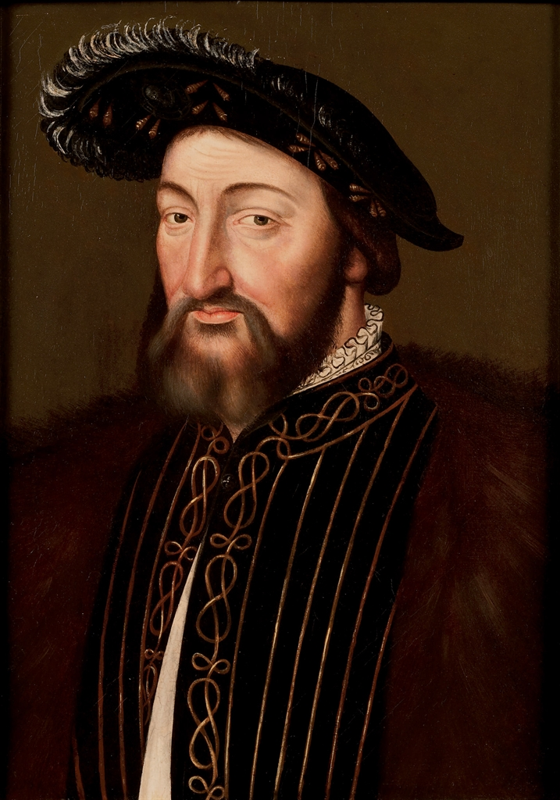
1534 – The Placard Campaign – King Francis I responds with persecution
Noblemen, academics, and merchants are drawn to Reformation theology
1st national synod in Paris – 1559; sets up a system of presbyteries
1561 – 2,150 Huguenot congregations; many come out of hiding to worship with the protection of armed guards
Some Huguenots advocate for armed rebellion
King Francis I

Slide 8
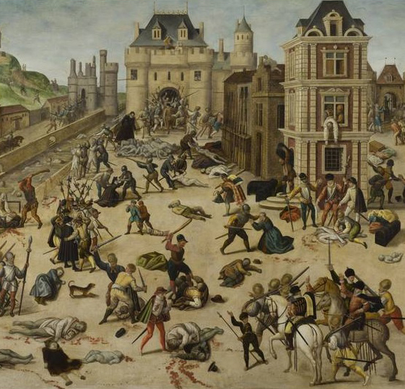
1562 – Catherine de’Medici (the Queen Mother) attempts to bring peace – issues an edict of toleration (limited)
1562 – 3,000 Huguenots are killed; civil war breaks out
1572 – The Massacre of St. Bartholomew’s Day – Catherine orders the murder of Admiral Coligny – tens of thousands of Huguenots are killed
1589 – last of Catharine’s sons dies – Henry VI of Navarre (House of Bourbon) becomes king – converts to Catholicism
“Paris is worth a mass”
1598 - The Edict of Nantes – 1st attempt at religious toleration in the same state – a Catholic state that tolerated Protestants within its boundaries

Slide 9
Reformed Churches in Holland
The Netherlands – ruled by Catholic Spain, but surrounded by Protestants
Reformed preachers flood into Holland
1559 - King Philip II of Spain sets up a form of The Inquisition and seeks to rid Holland of the “heretics”
Protestants meet for worship in fields, under armed guard
1561 – Protestants present to King Philip the Belgic Confession – it is rejected
Written with scholars from Geneva - Reformed

Slide 10
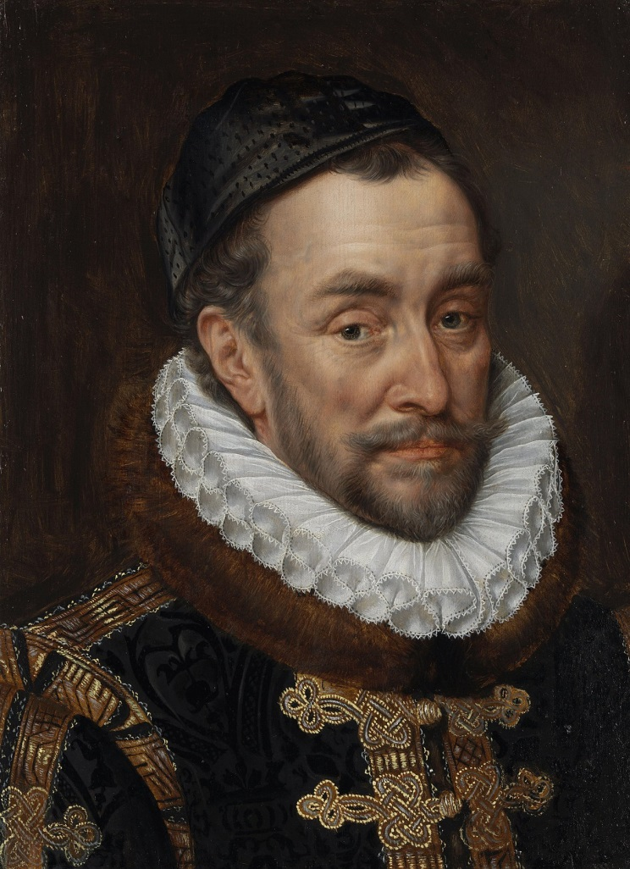
1566 – Reformed Synod declares armed resistance to persecution to be permissible
William (the Silent) of Orange becomes leader
King Philip raises an army to put down the rebellion under the Duke of Alba – “to drown the rebellion and heresy in blood”
William of Orange – army ineffective, but “the Beggars of the Sea” repeatedly defeat the Spanish navy
Protestants backed by England and the French Huguenots
Siege of Leyden – dikes are broken to allow ships to drive Spanish army away
Country divided – Protestants in the North (now the Netherlands)and Catholics in the South (now Belgium, Luxembourg)
William of Orange

Slide 11
