Slide 1
The reformation in england

Slide 2
“In Saxony (Germany), the impetus to the Reformation was first religious, and then political. In France and Holland and Scotland the Reformation began as a religious movement which was inevitably caught up into national politics. But this process was not universal… England was unique in its Reformation, unique in the Church established in consequence of the Reformation. The English Reformation was emphatically a political revolution, and its author King Henry VIII resisted, for a time ferociously, many of the religious consequences which accompanied the legal changes everywhere else in Europe.”
Owen Chadwick, The Reformation

Slide 3
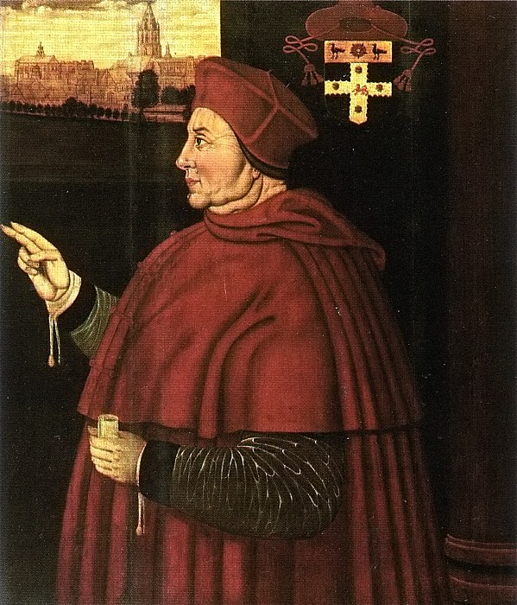
The Beginnings
Cardinal Thomas Wolsey – also Lord Chancellor - ruled church and state, under the King, largely independent of Rome
Corrupt & unpopular
Writings of Erasmus
The Lollards – followers of John Wycliffe
The White Horse Inn – scholars at Cambridge; “Little Germany”
Cardinal Thomas Wolsey

Slide 4
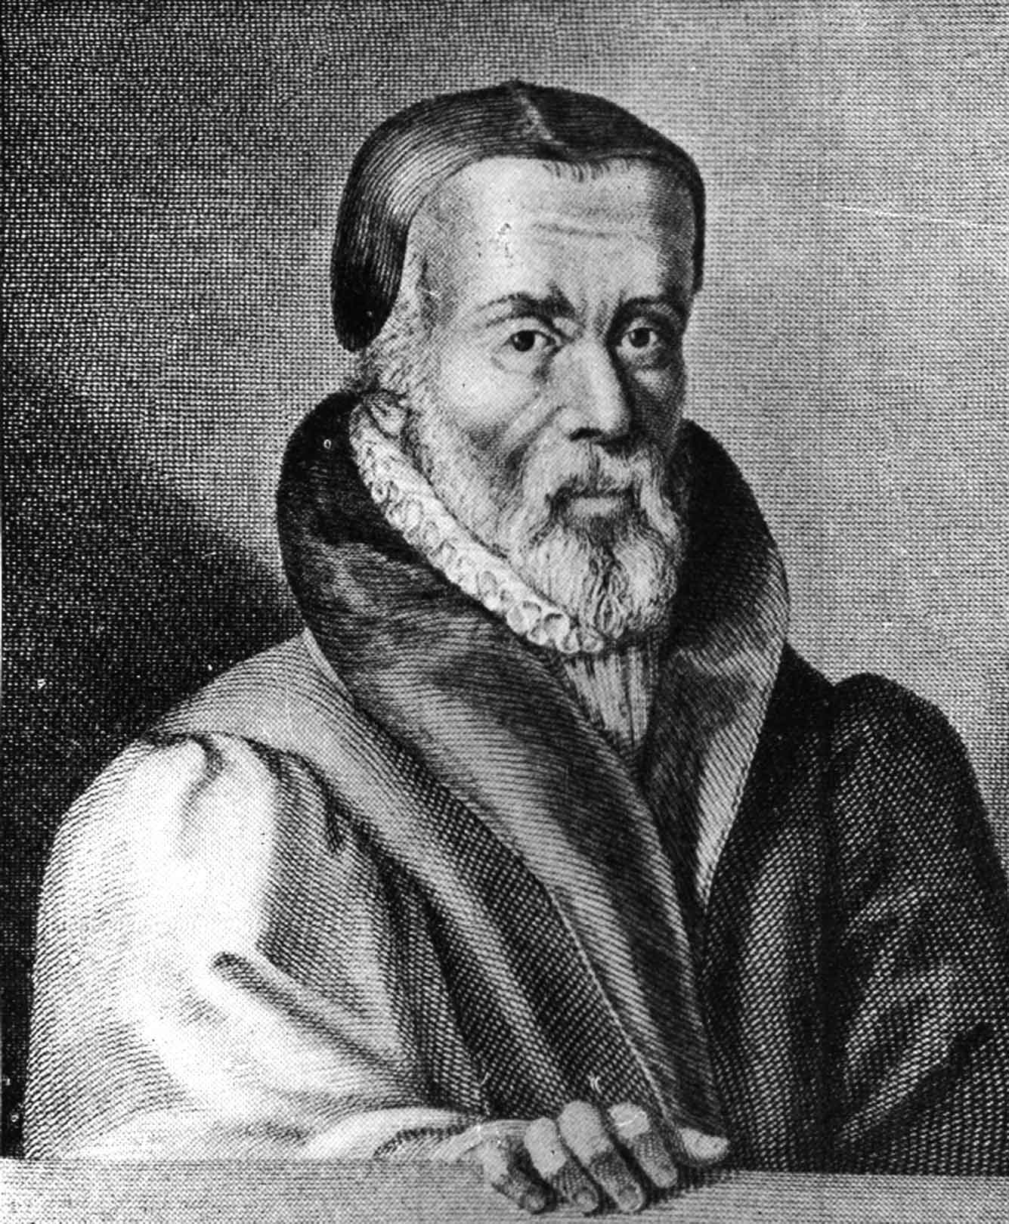
William Tyndale
Linguist – published first English translation of Scripture from original Greek and Hebrew in Worms, Germany
16,000 copies smuggled back to England
KJV – 85% of NT is Tyndale’s; 76% of OT
1535 - captured, strangled, and burned near Brussels
Last words: “Lord, open the King of England’s eyes.”

Slide 5
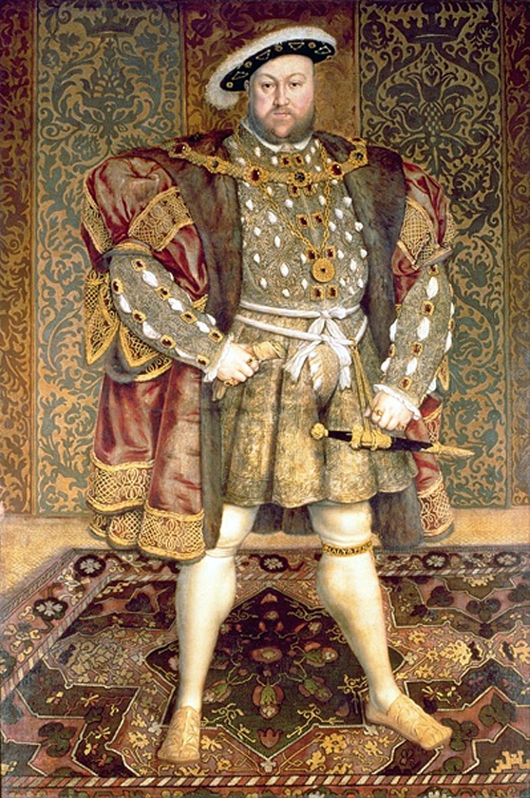
The Royal “Soap Opera”
King Henry VIII – political marriage to Catherine of Aragon, Spanish princess, aunt of Holy Roman Emperor Charles V - his brother’s widow
Required a Papal dispensation
Catherine is unable to bear a male child (daughter Mary is the only surviving child)
Henry requests a dispensation from Pope Clement VII for an annulment
Pope is between rock and a hard place
Henry begins changing laws and bishops that support the Pope
King Henry VIII

Slide 6
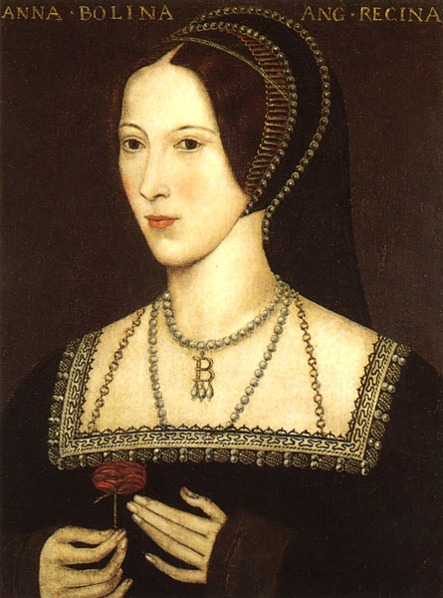
Henry marries Anne Boleyn, a committed Protestant
Anne bears a child – another daughter, Elizabeth
Cardinal Wolsey is executed; Thomas Cranmer becomes Archbishop of Canterbury
1533 – the Pope excommunicates Henry
False rumors lead to Anne being beheaded, then Henry marries Jane Seymour
Jane dies in childbirth – bears Henry’s only son, Edward VI
Anne Boleyn

Slide 7
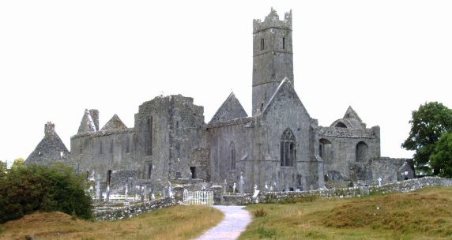
The Break with Rome
Henry was “a good Catholic” and “anti-Lutheran”– no desire to change the doctrine or practices of the church – the issue was authority
1534 – “The Act of Supremacy” – “the king is the supreme head of the Church of England”
Henry takes possession of 900 monasteries and their wealth – 1/5 to 1/3 of land in England
“(Henry) didn’t want England to become protestant, but nor did he want England to be Roman Catholic. He wanted an English Catholicism, stripped of all Roman ties and Roman corruptions.” Michael Reeves

Slide 8
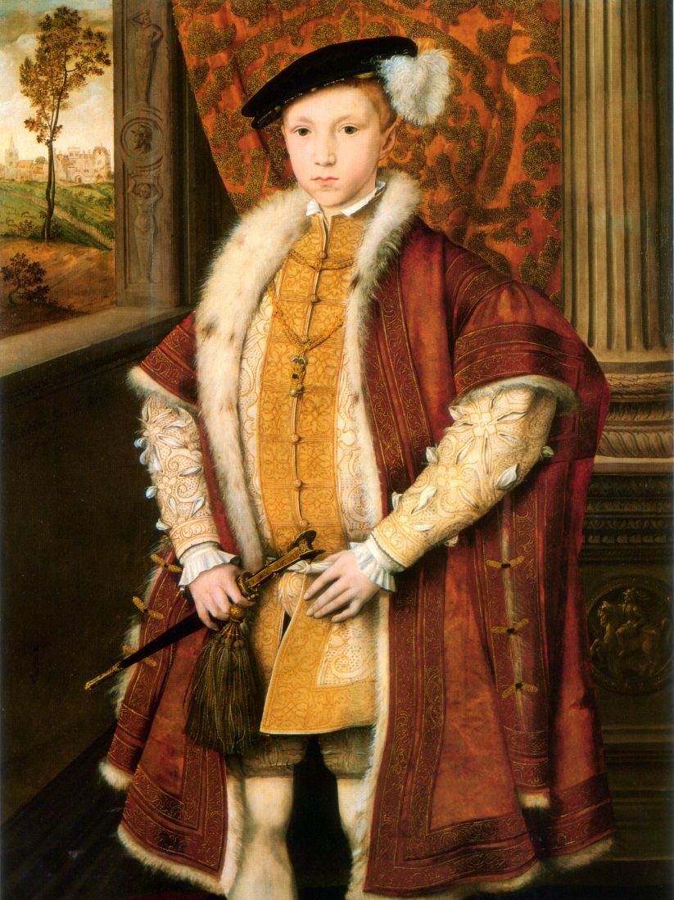
The True Reformation Arrives
1547 – Henry dies – Edward VI becomes King at the age of 9 – rules for only 6 years
Edward VI and his Lord Protector, the Duke of Somerset, were strong Protestants
Transition to Protestantism begins
Protestant refugees return to England
English Bible and liturgy in churches
Communion given in both kinds
Images and altars removed from churches
King Edward VI

Slide 9
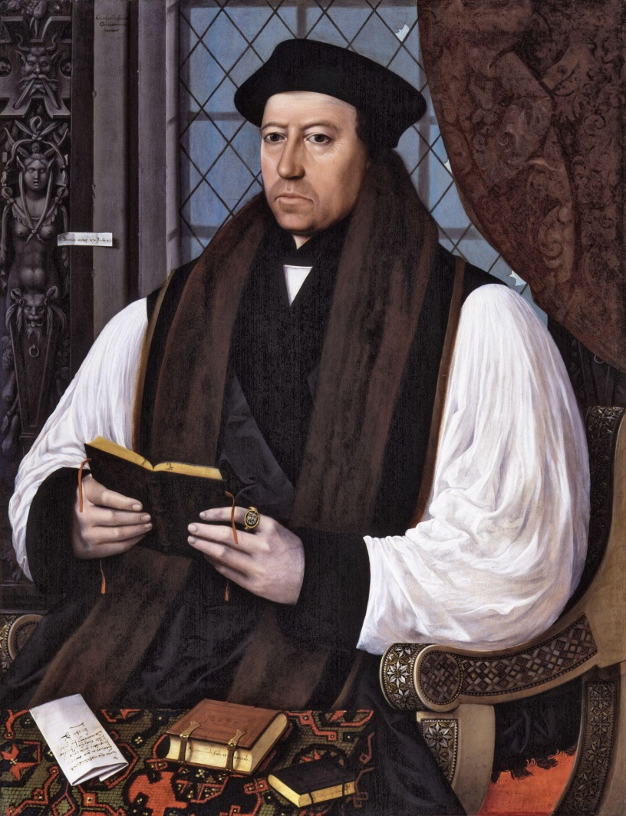
Thomas Cranmer
Studied in Germany, where he was married
In England she could only travel in a large box
Book of Common Prayer (1549)
English liturgy
Congregation as participants, not spectators
Sacrificial language removed
Lutheran approach to worship
“Too conservative for the radicals and too radical for the conservatives”
Book of Common Prayer (1552)
Simpler liturgy; more Reformed in content
England isn’t yet Protestant on a popular level

Slide 10
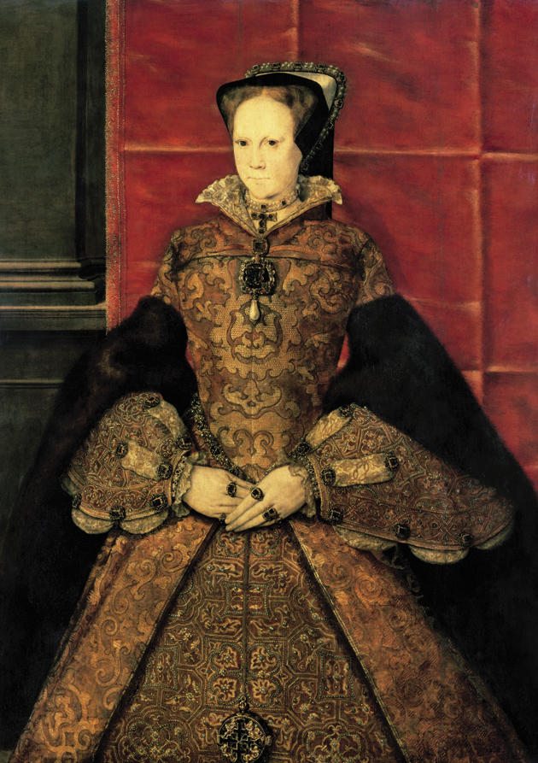
Reformation Interrupted
Lady Jane Grey – plot fails
“Bloody Mary” – daughter of Henry VIII and Catharine of Aragon
Strongly Catholic; seeks to reverse the Reformation
Protestant leaders leave England or are imprisoned
300 are martyred - Foxe
Thomas Cranmer – recants, then recants his recanting
1558 - Mary dies and leaves no heir – her actions push England toward the Reformers

Slide 11
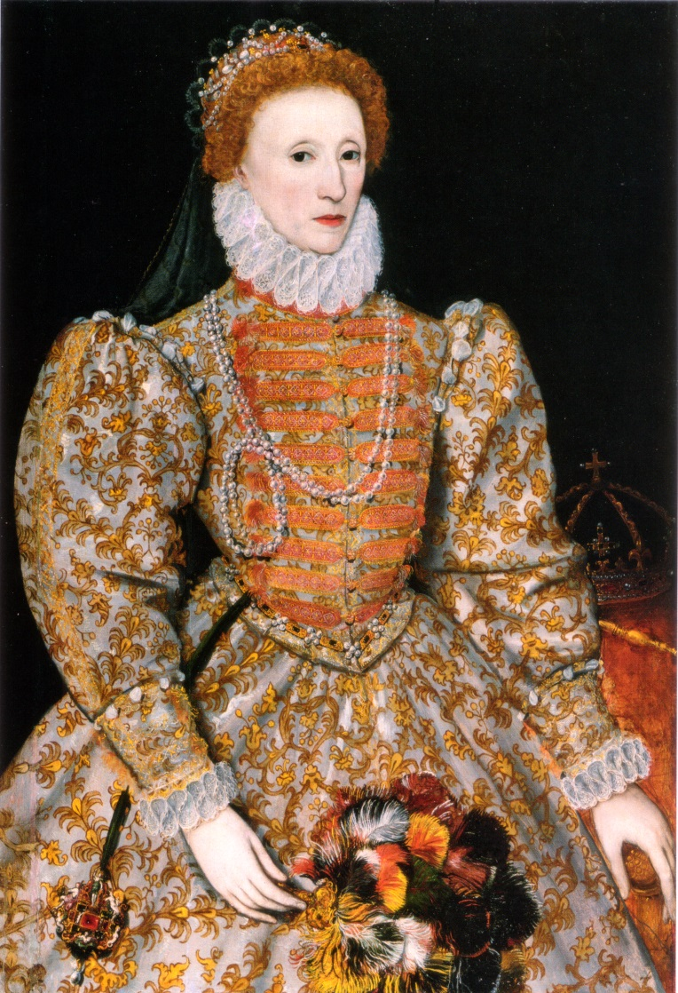
The Reformation Established
Queen Elizabeth – daughter of Henry VIII and Anne Boleyn – reigned from 1558-1603
One of England greatest monarchs
“The Elizabethan Settlement” – compromise between Reformed and Lutheran Protestantism
Mary’s actions are reversed
Book of Common Prayer (1559) is re-established
39 Articles of Faith (1562) – a moderate Protestantism
Exiled Protestants return – including John Knox

Slide 12
“…Elizabeth’s long reign turned out to be a war of attrition against Catholicism. When she first came to the throne, nobody expected it. But, as the years passed, Catholic practices simply fell into disuse, and Catholic priests trained in the old ways died out. In their place, Cranmer’s liturgy and homilies were heard by all, week after week; soon the only theology pastors could access was Protestant; soon the only Bible people knew was English, and ownership and knowledge of it slowly filtered into even the most rural areas. Elizabeth’s long reign ensured that the nation was Protestant.”
Michael Reeves

