Slide 1
Martin luther and the reformation in Germany

Slide 2
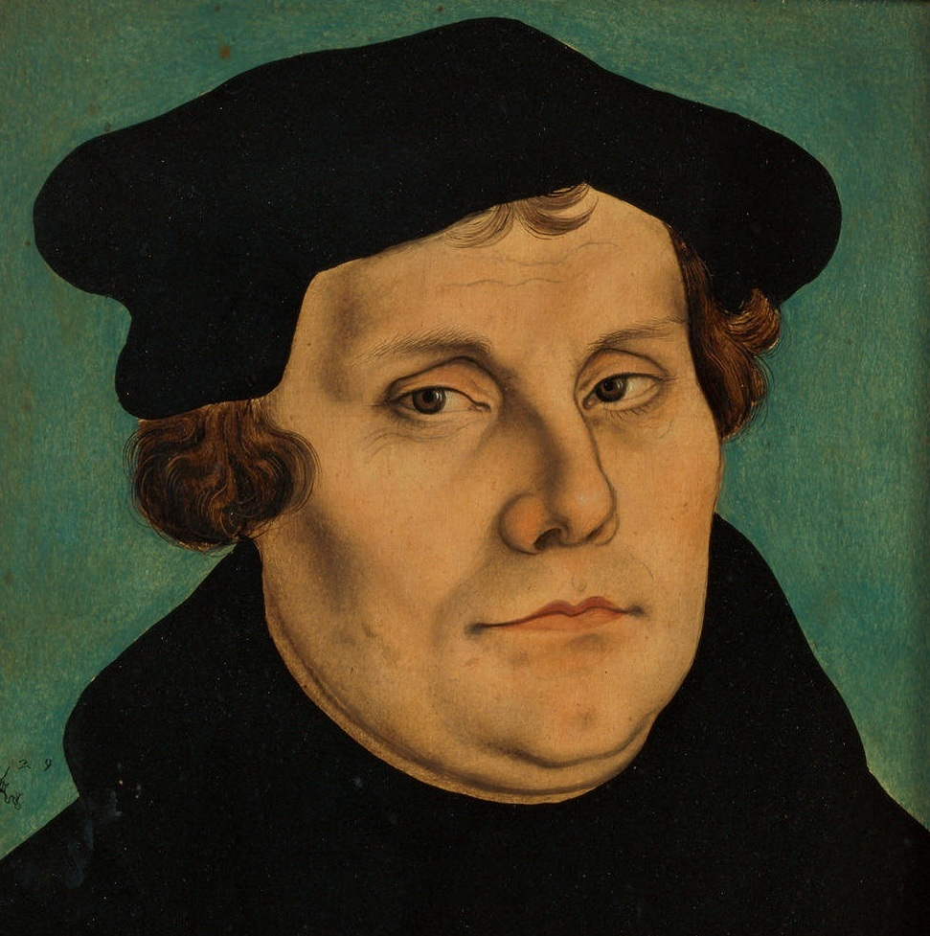
Martin Luther
Born in 1483 in central Germany
Father – mine worker who became mine owner
Hard and austere man; pushed Martin to be a lawyer
The thunderstorm and the monastery
Doubts and guilt
Disillusioning trip to Rome

Slide 3
“He was a tough, four-square man of peasant stock, with deep-set disturbing eyes and a character as open as daylight. His mind was active and vigorous, but he was no gymnast of the intellect, a man earnest and persevering rather than subtle and delicate in discrimination. His friends always respected him with an affectionate and sometimes rueful regard, knowing that he held nothing back from them, erected no screen, allowed them to touch his real inwardness. He never ceased to be a peasant, and was proud of his peasant blood. He could be rough in language, vulgar, crude, coarse. He had humor and loud laughter, but not wit.”
Owen Chadwick

Slide 4
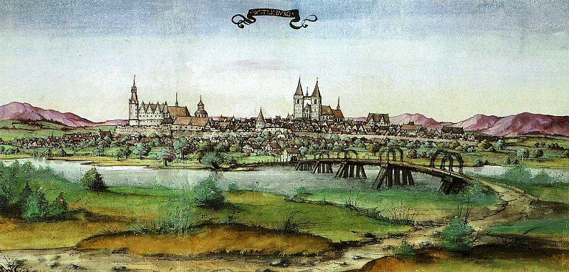
Luther in Wittenberg
teaching on Psalms
The love of God
teaching on Romans
Man’s inability to do good
“The just shall live by faith”
“The righteousness of God” – God’s gift

Slide 5
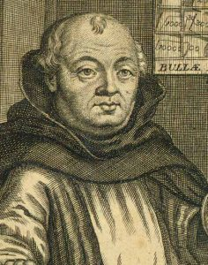
Johann Tetzel and the Indulgences
The debt of Archbishop Albert of Mainz and the rebuilding of St. Peter’s in Rome
“When the coin in the coffer rings, the soul from purgatory springs”
“Place your penny on the drum, the pearly gates open and in strolls mum”

Slide 6
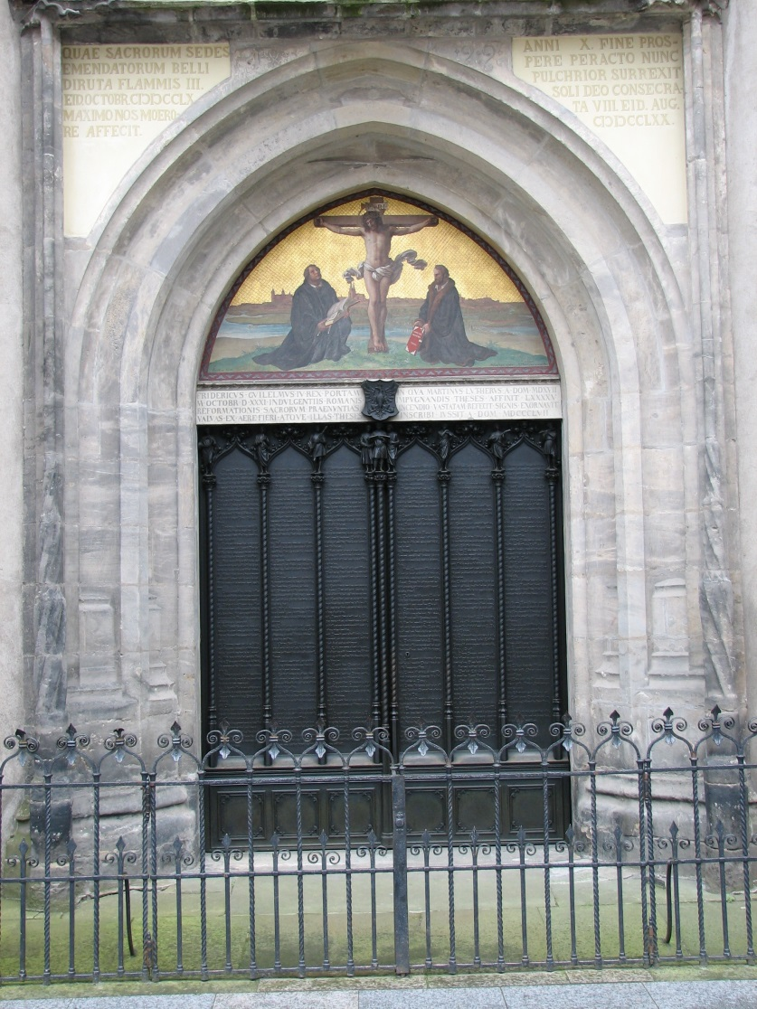
“The 95 Theses on the Indulgences”
All Saints’ Eve, 1517
Written in Latin – intended for scholarly debate
No mention of justification by faith or any other core Reformation doctrine
Protested the abuse of indulgences

Slide 7
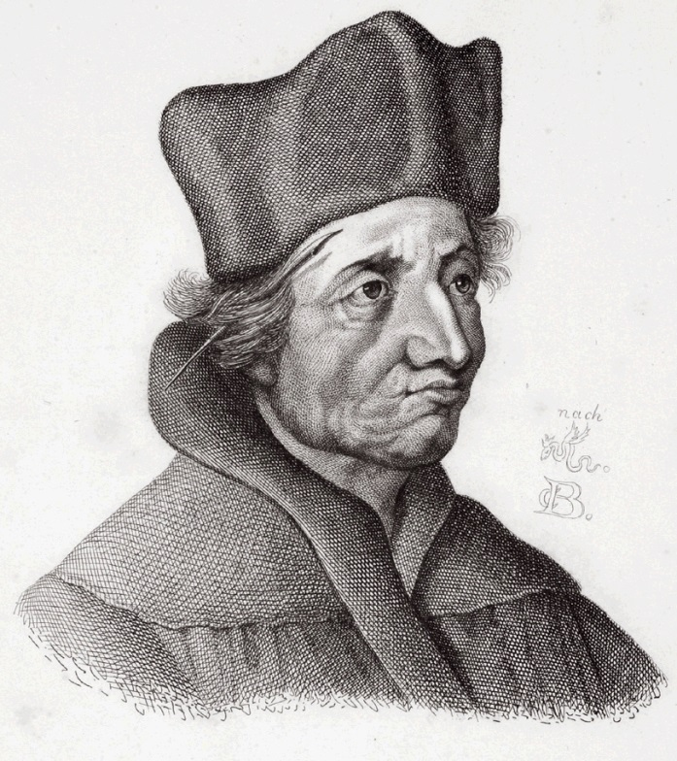
Response to the 95 Theses
Theses are printed and spread throughout Germany
Johann Eck – debate with Luther (1519)
The central issue: Is Scripture or the Pope the final authority?
Declares Luther to be a disciple of Jan Hus and forces Luther to admit Hus was right on some things
1520 – Luther: “We are all Hussites… St. Paul and St. Augustine are Hussites”
Popular support for Luther grows; Elector Frederick of Saxony protects him

Slide 8
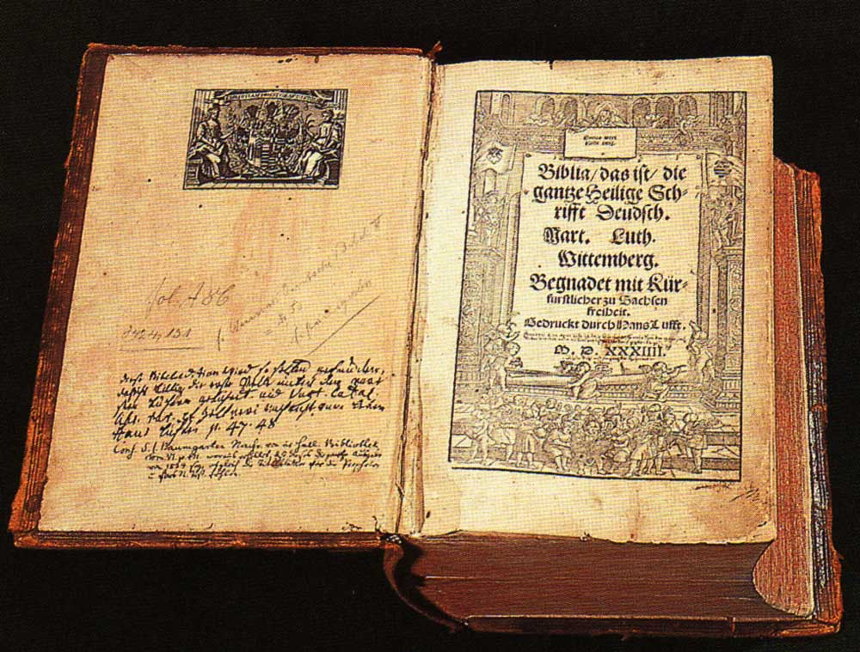
Luther’s Theology Spreads
“Sola Scriptura”
“Sola Gratia”
“Sola Fide”
“priesthood of all believers”
Laypeople – especially princes and kings – must reform the church

Slide 9
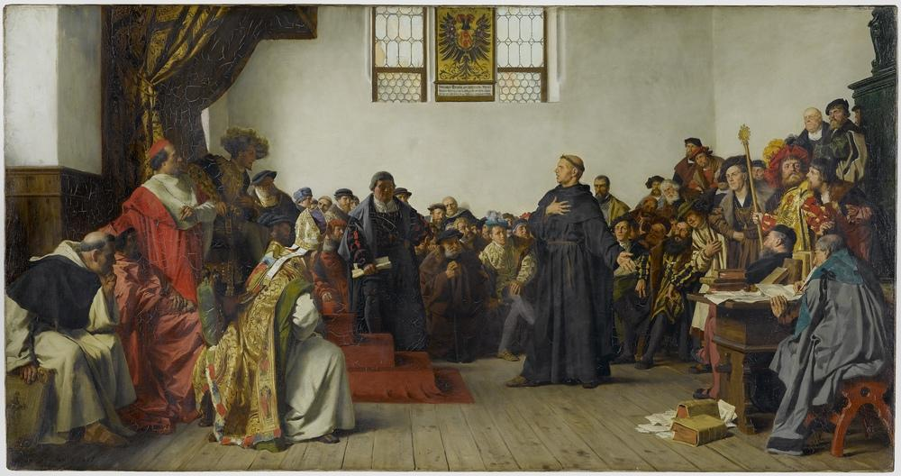
Luther Condemned
1520 – Papal bull “Exsurge Domine” is issued proclaiming Luther to be a heretic
Luther and followers burn the bull and other books containing church law and decrees
1521 – Luther is excommunicated
Charles V, Holy Roman Emperor, calls for the Diet of Worms to resolve the issue
Luther expects to debate; only asked 2 questions – “Are these your writings? Will you recant?”

Slide 10
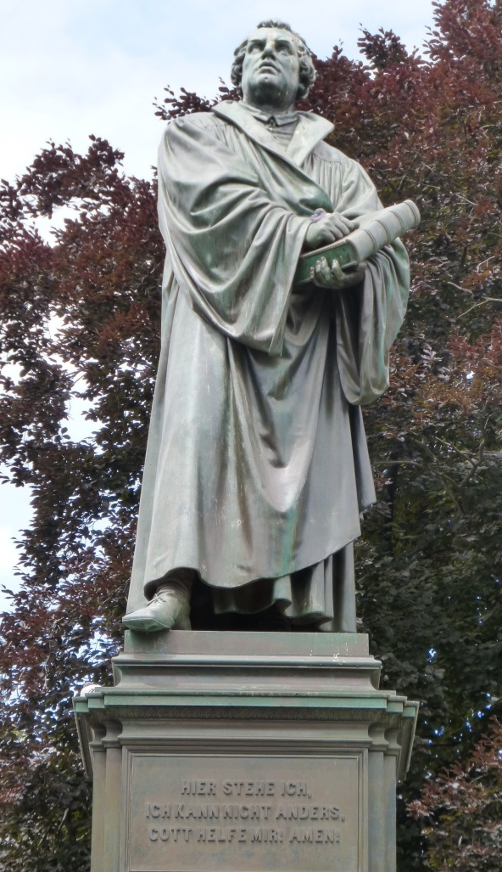
“Unless I am convinced by the testimony of the Holy Scriptures or by evident reason - for I can believe neither pope nor councils alone, as it is clear that they have erred repeatedly and contradicted themselves - I consider myself convicted by the testimony of Holy Scripture, which is my basis; my conscience is captive to the Word of God. Thus I cannot and will not recant, because acting against one's conscience is neither safe nor sound. God help me. Amen.”

Slide 11
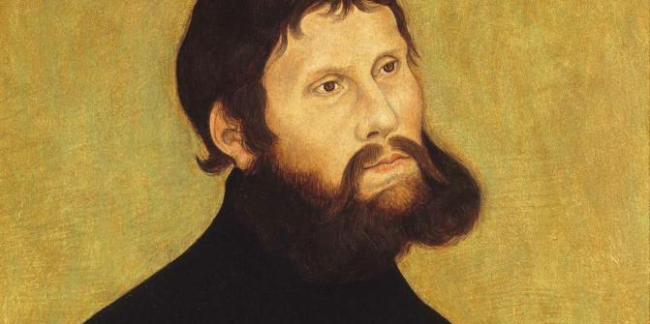
Luther at Wartburg Castle
“Kidnapped” by Elector Frederick of Saxony on the way home from Worms
Disguised as “Squire George”
1 year - A time of spiritual warfare, doubts, depression
Translated the New Testament into German; many other writings

Slide 12
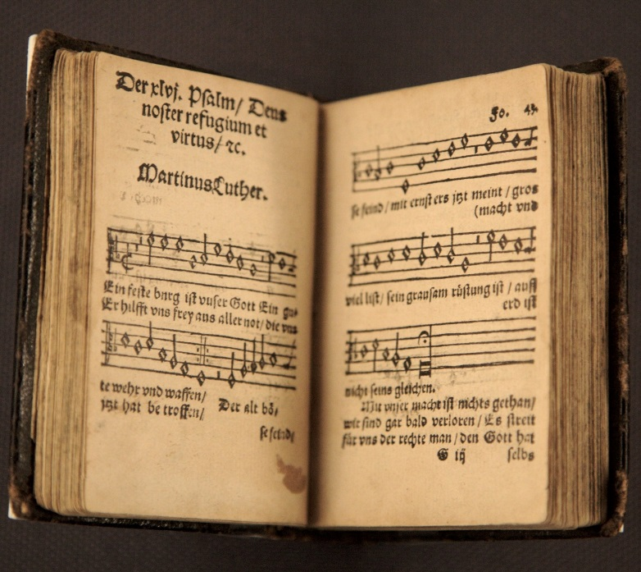
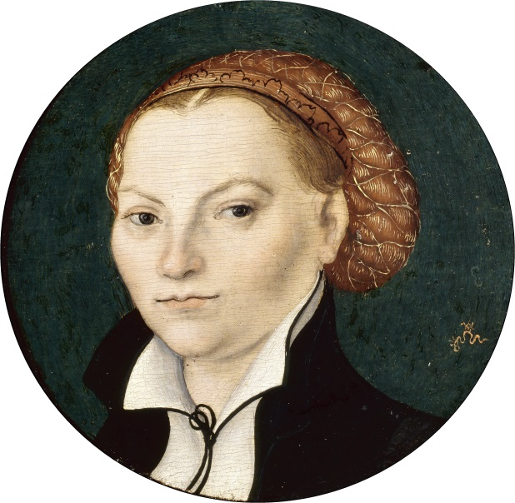
Back in Wittenberg
Luther returns to quell violent uprisings by the peasants
Simplifies worship liturgy – in German, no sacrificial language, more preaching
Introduces congregational singing
Writes hymns & catechisms
Married a former nun, Katarina von Bora
Responds to Erasmus’ “On the Freedom of the Will” with “The Bondage of the Will”

Slide 13
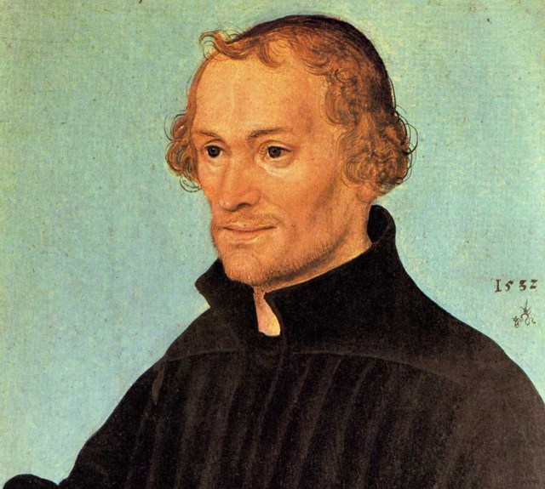
Philip Melanchthon
Luther’s friend and advisor from 1521 on
Opposite of Luther in temperament – quiet, scholarly, gentle, courteous, conciliatory
1530 – wrote The Augsburg Confession
Rejected by the Emperor, but accepted by nine German princes
1555 – “The Peace of Augsburg” – ends religious wars for 60 years
Rulers determine whether the churches under their reign will be Lutheran or Catholic

