Slide 1
Lesson #6 - Inerrancy

Slide 2
The God-Breathed Word
“All Scripture is breathed out by God and profitable for teaching, for reproof, for correction, and for training in righteousness, that the man of God may be complete, equipped for every good work.” II Timothy 3:16
“The doctrine of biblical inerrancy is no late imaginative creation of A. A. Hodge and B. B. Warfield in 1881 or of twentieth-century American fundamentalism. Rather, it is an essential evangelical belief based upon a biblical warrant. It resides squarely within the Augustinian tradition regarding the Bible’s truthfulness. Both Roman Catholics and the Protestant Reformers affirmed the church doctrine.”
Dr. John D. Woodbridge, Trinity Evangelical Divinity School

Slide 3
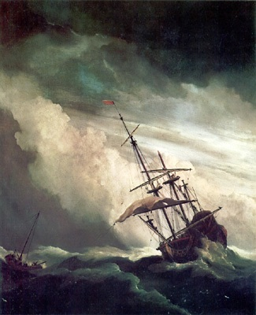
The Human and Divine Word
“None of these (Scriptural) authors has erred in any respect of writing.” Augustine
“And we have the prophetic word more fully confirmed… knowing this first of all, that no prophecy of Scripture comes from someone's own interpretation. For no prophecy was ever produced by the will of man, but men spoke from God as they were carried along by the Holy Spirit.” II Peter 1:19-21
“…the church has historically confessed that Scripture is the Word of God. It is God speaking to us. There are also human authors of Scripture, and the content of Scripture reflects their personalities, styles, and experiences. But the humanity of Scripture does not mean that Scripture has less authority than, say, the divine voice at Mount Sinai. The authority of Scripture is nothing less than the authority of God Himself…” John Frame

Slide 4
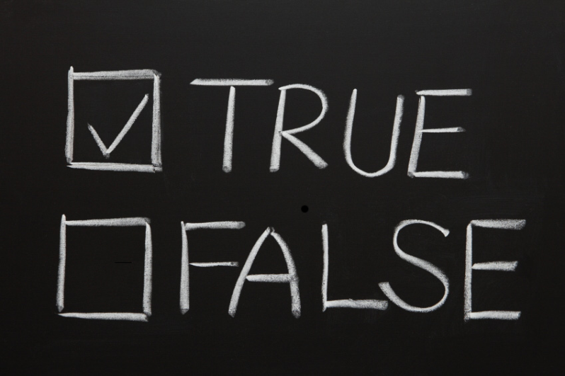
Definition
“Inerrancy means that when all facts are known, the Scriptures in their original autographs and properly interpreted will be shown to be wholly true in everything that they affirm, whether that has to do with doctrine or morality or with the social, physical, or life sciences.”
Dr. Paul Feinberg, Trinity Evangelical Divinity School

Slide 5
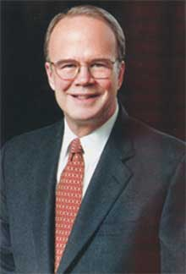
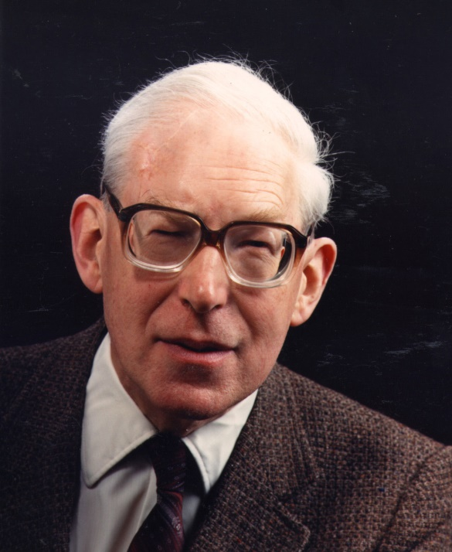
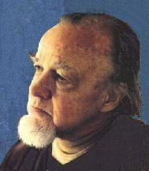
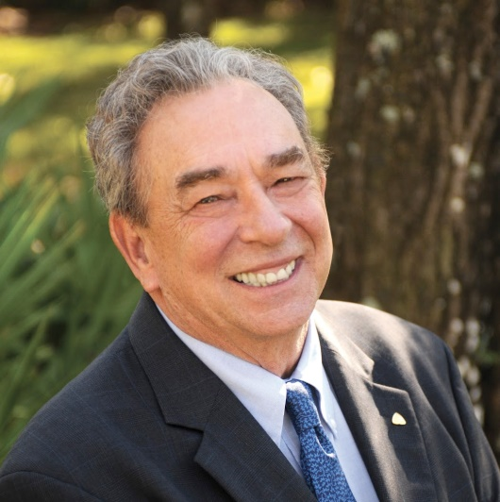
A Definitive Statement
“The Chicago Statement on Biblical Inerrancy was formulated in 1978 by approximately 300 evangelical scholars at a conference sponsored by the International Council on Biblical Inerrancy, held in Chicago. The statement was designed to defend the position of Biblical inerrancy against trends toward liberal conceptions of Scripture and higher biblical criticism. The undersigners came from a variety of evangelical denominations, and include James Montgomery Boice, Carl F. H. Henry, Roger Nicole, J. I. Packer, Francis Schaeffer, and R. C. Sproul.” Theopedia

Slide 6
Chicago Statement on Biblical Inerrancy, Article X – In the Autographs
“We affirm that inspiration, strictly speaking, applies only to the autographic text of Scripture, which in the providence of God can be ascertained from available manuscripts with great accuracy. We further affirm that copies and translations of Scripture are the Word of God to the extent that they faithfully represent the original.”
“We deny that any essential element of the Christian faith is affected by the absence of the autographs. We further deny that this absence renders the assertion of Biblical inerrancy invalid or irrelevant.”

Slide 7
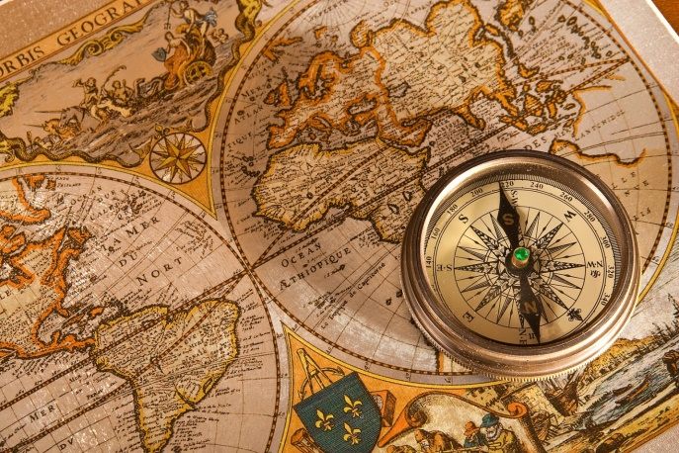
Chicago Statement on Inerrancy, Articles XI and XII – In All of Its Parts
“We affirm that Scripture, having been given by divine inspiration, is infallible, so that, far from misleading us, it is true and reliable in all the matters it addresses.”
“We deny that it is possible for the Bible to be at the same time infallible and errant in its assertions. Infallibility and inerrancy may be distinguished, but not separated.”
“We affirm that Scripture in its entirety is inerrant, being free from all falsehood, fraud, or deceit.”
“We deny that Biblical infallibility and inerrancy are limited to spiritual, religious, or redemptive themes, exclusive of assertions in the fields of history and science. We further deny that scientific hypotheses about earth history may properly be used to overturn the teaching of Scripture on creation and the flood.”

Slide 8
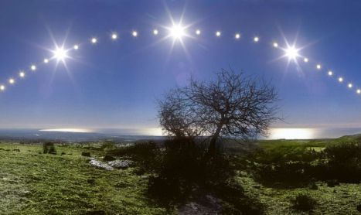
Chicago Statement on Biblical Inerrancy, Article X – In Common Use
“We affirm the propriety of using inerrancy as a theological term with reference to the complete truthfulness of Scripture.”
“We deny that it is proper to evaluate Scripture according to standards of truth and error that are alien to its usage or purpose. We further deny that inerrancy is negated by Biblical phenomena such as a lack of modern technical precision, irregularities of grammar or spelling, observational descriptions of nature, the reporting of falsehoods, the use of hyperbole and round numbers, the topical arrangement of material, variant selections of material in parallel accounts, or the use of free citations.”

Slide 9
Inconsistencies and Contradictions?
“The fact is, a whole lot of the inconsistencies alleged by skeptics turn out not to be problematic at all when you read them a little more carefully. Despite two centuries of nitpicking, scholars have proposed plausible resolutions to every single one of the alleged inconsistencies. You just need sufficient intellectual integrity to take the time to look them up in a book.”
Greg Gilbert, Why Trust the Bible?

Slide 10
Creation Contradictions?
6 Days or 1 Day?
“…in the day that the LORD God made the earth and the heavens.” Genesis 2:4
Plants & Animals First, or Man First?
“When no bush of the field was yet in the land and no small plant of the field had yet sprung up… then the LORD God formed the man of dust from the ground…” Genesis 2:5-7
“Now out of the ground the LORD God had formed every beast of the field and every bird of the heavens…” Genesis 2:19

Slide 11
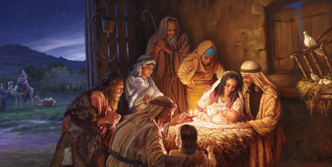
Nativity Contradictions?
Bethlehem and Nazareth
Different Geneaologies
“…and Jacob the father of Joseph the husband of Mary, of whom Jesus was born, who is called Christ.” Matthew 1:16
“Jesus, when he began his ministry, was about thirty years of age, being the son (as was supposed) of Joseph, the son of Heli…” Luke 3:23
Matthew: through Joseph
Luke: through Mary

Slide 12
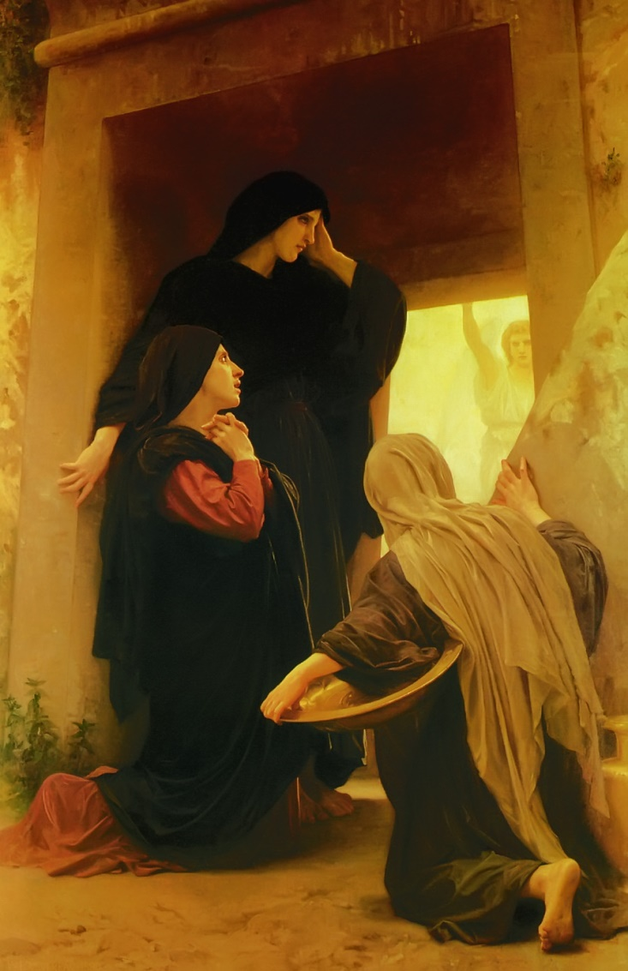
Resurrection Contradictions?
Matthew – 2 women (Mary Magdalene & the other Mary); 1angel; departure to tell disciples; encounter with risen Jesus on the way
Mark – 3 women (Mary Magdalene, Mary the mother of James, and Salome); 1 angel; women depart and tell no one
Luke – more than 3 women (Mary Magdalene, Mary the mother of James, Joanna; others); 2 angels; trip back into the city to tell the disciples, who disbelieve; Peter’s trip to the tomb, finding it empty
John – 1 woman (Mary Magdalene); departure to tell Peter and John the body is missing; Peter and John run to tomb; Mary later encounters 2 angels outside the tomb, then the risen Jesus; Mary runs to tell the disciples

Slide 13
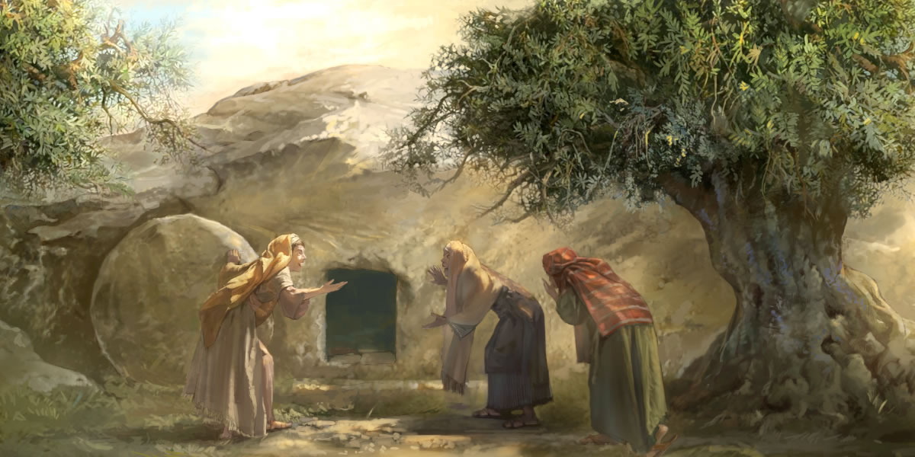
A Possible Harmonization – George Elden Ladd, Fuller Theo. Seminary
Four or more women approach tomb, see the stone rolled away
Mary Magdalene rushes off to tell Peter and John the body is missing
Other women encounter two angels at the tomb and hear of the resurrection; they leave and tell no one at first
Jesus meets these women and sends them to tell the disciples

Slide 14
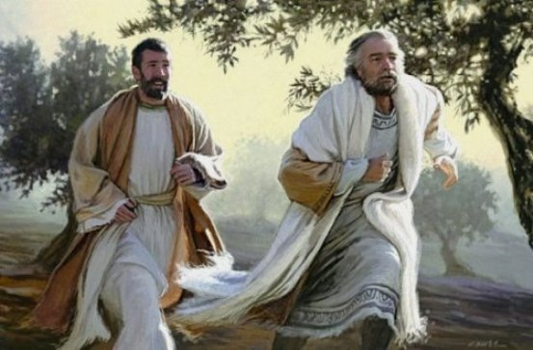
Peter and John, having been informed by Mary, go to the tomb, arrive after the group of women had left, and find it empty; they return to tell the disciples.
Mary arrives at the tomb after Peter and John leave, not having heard the angels’ message yet; she encounters the two angels and then the risen Jesus.
The group of women finally go to tell the disciples, and then Mary comes to tell the disciples her experience.

