Slide 1
Lesson #5 – Revelation and Inspiration

Slide 2
Sources of Authority
Revelation – oral or written
Investigation – rational, philosophical, scientific
Relational – trusted sources
Experience – feelings

Slide 3
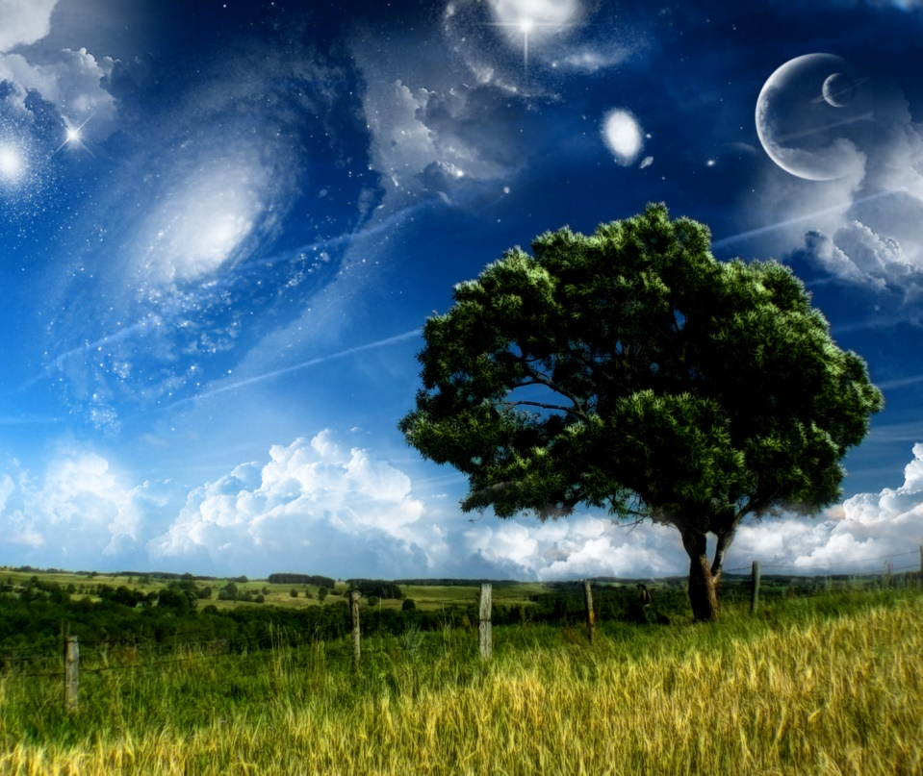
General Revelation
“For the wrath of God is revealed from heaven against all ungodliness and unrighteousness of men, who by their unrighteousness suppress the truth. For what can be known about God is plain to them, because God has shown it to them. For his invisible attributes, namely, his eternal power and divine nature, have been clearly perceived, ever since the creation of the world, in the things that have been made. So they are without excuse. For although they knew God, they did not honor him as God or give thanks to him, but they became futile in their thinking, and their foolish hearts were darkened.” Romans 1:18-21

Slide 4
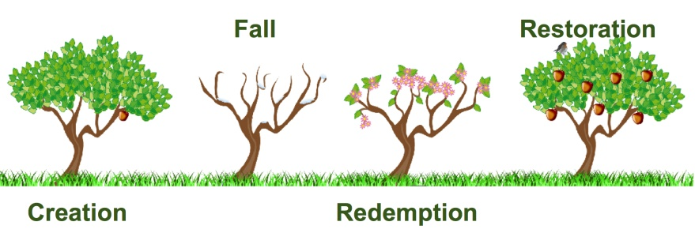
Special Revelation
“Redemption is partly objective and central, and partly subjective and individual... revelation accompanies the process of objective-central redemption only, and this explains why redemption extends further than revelation” – Geerhardus Vos
Objective Redemption: “Those redeeming acts of God, which take place on behalf of, but outside of, the human person” – “Redemption Accomplished”
e.g., the Abrahamic Covenant, the Exodus, crucifixion and resurrection of Christ, Pentecost
Subjective Redemption: “Those acts of God which enter into the human subject” – “Redemption Applied”
Regeneration, justification, sanctification

Slide 5
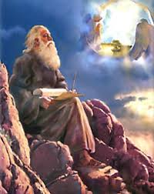
Methods of Special Revelation
“Long ago, at many times and in many ways, God spoke to our fathers by the prophets, but in these last days he has spoken to us by his Son, whom He appointed the heir of all things, through whom also He created the world. He is the radiance of the glory of God and the exact imprint of his nature, and He upholds the universe by the word of His power.” Hebrews 1:1-3
“Many ways”: verbal encounters, symbols, writings, theophanies, dreams, visions, prophecies, incarnation

Slide 6
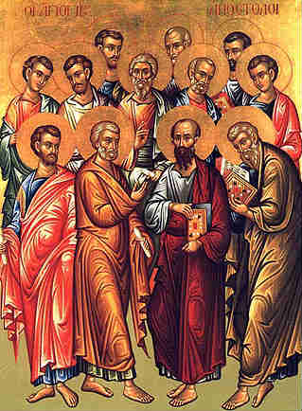
The Authoritative Witnesses to the Resurrection of Jesus Christ
“But when the Helper comes, whom I will send to you from the Father, the Spirit of truth, who proceeds from the Father, He will bear witness about Me. And you also will bear witness, because you have been with Me from the beginning… I still have many things to say to you, but you cannot bear them now. When the Spirit of truth comes, He will guide you into all the truth…”
John 15:26,27; 16:12,13

Slide 7
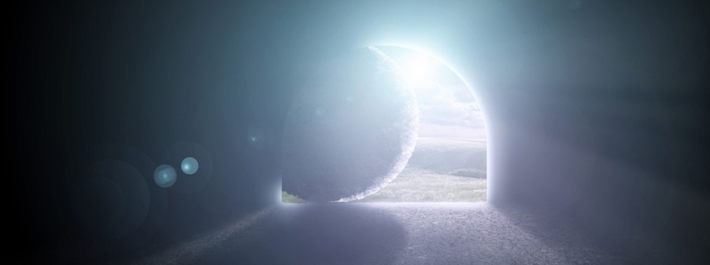
We Can Trust the Translation, Transmission, and Canon… But Can We Trust the Apostolic Witnesses?
“So one of the men who have accompanied us during all the time that the Lord Jesus went in and out among us, beginning from the baptism of John until the day when He was taken up from us – one of these men must become with us a witness to His resurrection.”
Acts 1:21,22
“Here’s what you really can’t get around: If the resurrection happened, then the rest of the fundamental superstructure of Christianity comes together like clockwork – including the authority of the Bible, both New Testament and Old. If it didn’t happen, then never mind any of it…” Greg Gilbert

Slide 8
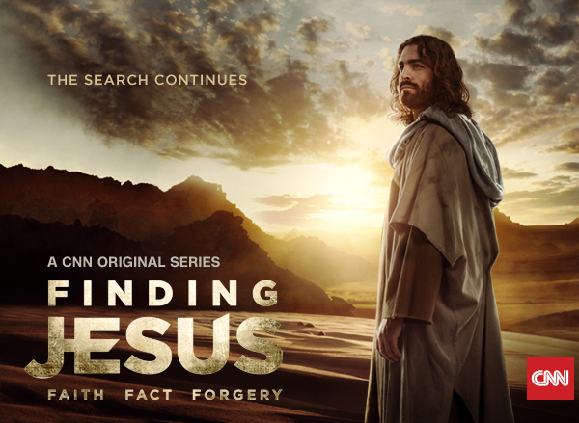
Who Needs Eyewitnesses?
The Shroud of Turin
Relics associated with the Cross of Christ
The Gospel of Judas
Relics associated with John the Baptist
The supposed burial box of Jesus’ brother James
The Gospel of Mary Magdalene

Slide 9
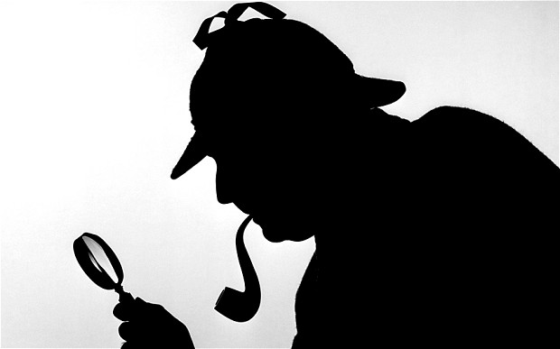
Possible Explanations for the Apostolic Witness
An inspirational legend
An intentional hoax
A big misunderstanding
An eyewitness report of an historic event

Slide 10
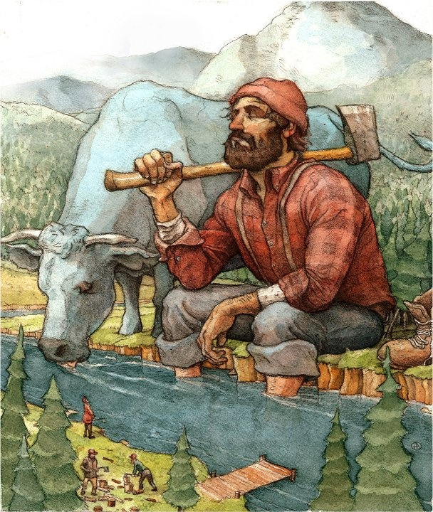
An Inspirational Legend?
“Inasmuch as many have undertaken to compile a narrative of the things that have been accomplished among us, just as those who from the beginning were eyewitnesses and ministers of the word have delivered them to us, it seemed good to me also, having followed all things closely for some time past, to write an orderly account for you, most excellent Theophilus…” Luke 1:1-3
“In the fifteenth year of the reign of Tiberius Caesar, Pontius Pilate being governor of Judea, and Herod being tetrarch of Galilee, and his brother Philip tetrarch of the region of Ituraea and Trachonitis, and Lysanias tetrarch of Abilene, during the high priesthood of Annas and Caiaphas, the word of God came to John the son of Zechariah in the wilderness.” Luke 3:1,2
21 verifiable references to historical people, places, and circumstances

Slide 11
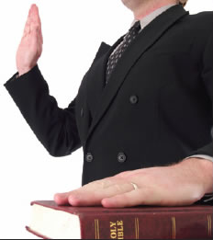
“That which was from the beginning, which we have heard, which we have seen with our eyes, which we looked upon and have touched with our hands, concerning the word of life – the life was made manifest, and we have seen it, and testify to it and proclaim to you the eternal life, which was with the Father and was made manifest to us – that which we have seen and heard we proclaim also to you…” I John 1:1-3
“For I delivered to you as of first importance what I also received: that Christ died for our sins in accordance with the Scriptures, that he was buried, that he was raised on the third day in accordance with the Scriptures, and that he appeared to Cephas, then to the twelve. Then He appeared to more than five hundred brothers at one time, most of whom are still alive, though some have fallen asleep. Then he appeared to James, then to all the apostles. Last of all, as to one untimely born, he appeared also to me.” I Corinthians 15:3-8

Slide 12
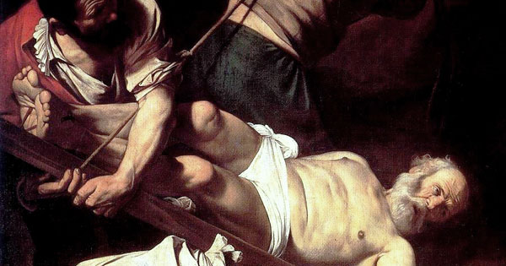
A Hoax?
The New Testament was written between 45 AD and 95 AD – other witnesses were alive
Many of the witnesses were opponents of Christ
Many New Testament authors weren’t respected or presented as heroes – Matthew, Mark, Peter
For what purpose? Money, fame, power?
No one dies for a hoax

Slide 13
A Big Misunderstanding?
A mass hallucination? Mass denial?
1st century Jews – understood resurrection as a universal bodily resurrection at the end of time
“…these words seemed to them an idle tale, and they did not believe them.” Luke 24:11
“And when they saw Him they worshipped Him, but some doubted.” Matthew 28:17

Slide 14
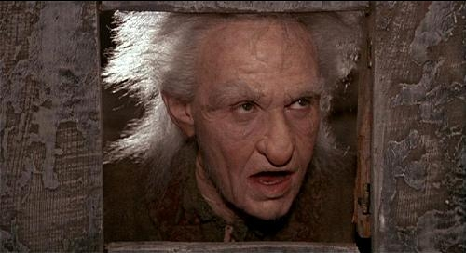
Wrong tomb? Only “mostly dead”?
Remember the Roman guards and Pilate’s seal
“Are we really to think that Jesus – somehow managing to survive His crucifixion – staggered wounded, crucified, spear-stabbed, and now dehydrated and starving into the presence of his disciples and convinced them, frightened and skeptical though they were, that He was the Lord of Life and Conqueror of Death? Not highly likely, I’d say. They wouldn’t have gone out to preach at that point; they would have gotten Him a doctor.” Greg Gilbert

Slide 15
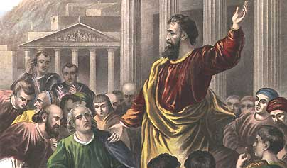
The Reasonable Conclusion
“And with great power the apostles were giving their testimony to the resurrection of the Lord Jesus, and great grace was upon them all.” Acts 4:33
“Look, when you come right down to it, the evidence before us – the early Christians’ confident insistence that the tomb was empty and that they saw the risen Jesus, the life-altering beliefs that flowed from those experiences, their resolute embracing of their faith even in the face of death – this evidence is explained by only one possibility: Jesus was really, truly, bodily, historically resurrected from the dead.” Greg Gilbert

Slide 16
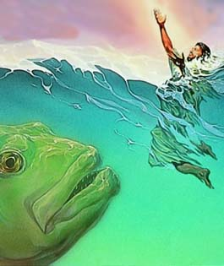
The Testimony of the Risen Christ
The temptations – countered by Scripture
“For truly I say to you, until heaven and earth pass away, not an iota, not a dot will pass from the Law until all is accomplished.” Matthew 5:18
The historicity of Jonah – “For just as Jonah was three days and three nights in the belly of the great fish, so will the Son of Man be three days and three nights in the heart of the earth.” Matthew 12:40
Also Noah, Abraham, Moses, David, Solomon, etc.

Slide 17
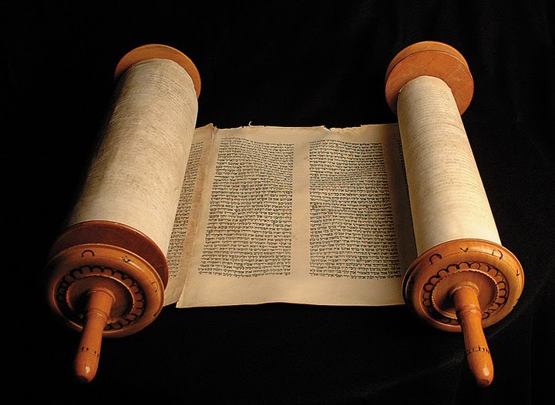
“…Scripture cannot be broken…” John 10:35
“Today this Scripture has been fulfilled in your hearing.” Luke 4:21
“And beginning with Moses and all the Prophets, He interpreted to them in all the Scriptures the things concerning Himself… ‘These are My words that I spoke to you while I was still with you, that everything written about Me in the Law of Moses and the Prophets and the Psalms must be fulfilled.” Matthew 24:27,44

Slide 18
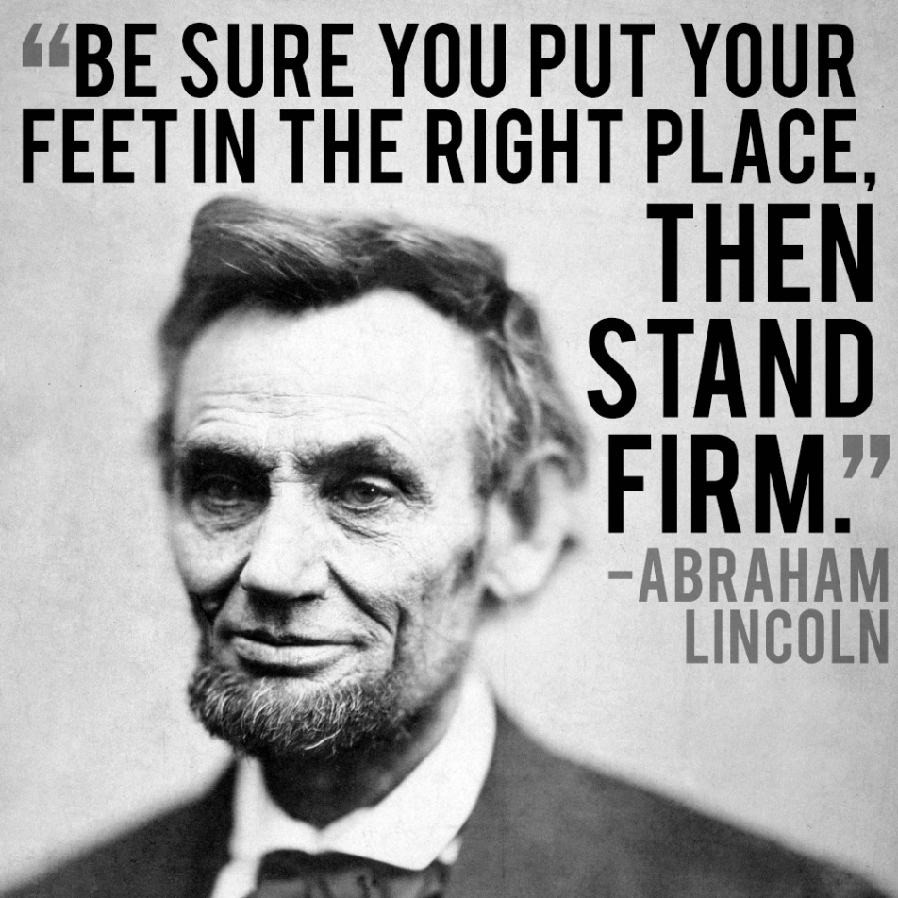
The Chain of Important Questions
Can we trust the translation?
Can we trust the process of transmission?
Can we trust the canon?
Can we trust the original authors?
Can we trust the Bible?

