Slide 1
Lesson #3 – Transmission of the Text

Slide 2
Copies of Copies – Can We Trust the Hebrew and Greek Text?
“Many have undertaken to draw up an account of the things that have been fulfilled among us, just as they were handed down to us by those who from the first were eyewitnesses and servants of the word.”
Luke 1:1,2

Slide 3
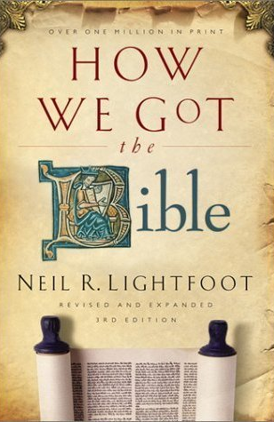
Resource
How We Got the Bible, by Neil R. Lightfoot

Slide 4
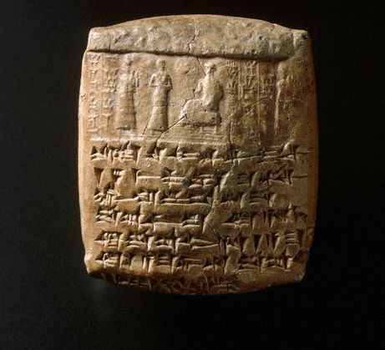
Early Writing & Materials
Writing existed by 3,000 BC
Alphabetic script existed in Palestine by 1,700 BC
Early materials – stone, clay, wood, metal
Papyrus – first used in Egypt ~ 3,000 BC
“biblia” – a Greek term for papyrus rolls – Bible
Leather / Parchment / Vellum
first used in Egypt ~ 2,500 BC
“When you come, bring the cloak that I left with Carpus at Troas, also the books, and above all the parchments.” II Tim. 4:13

Slide 5
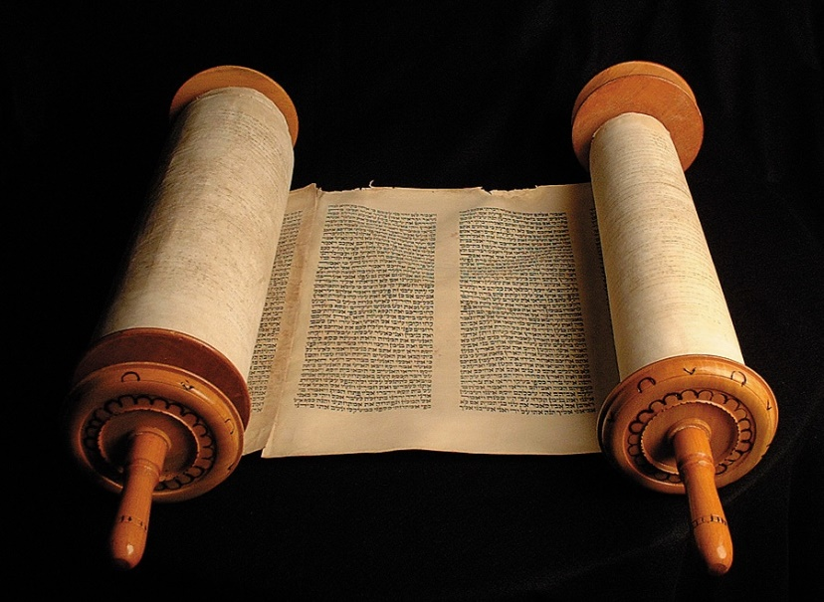
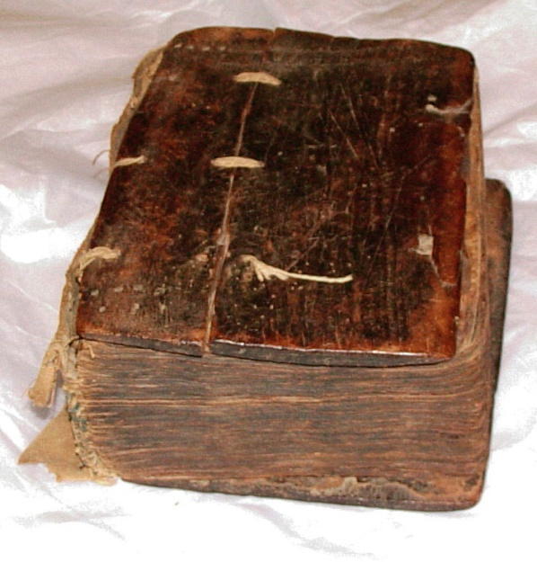
Evolution of the Book
Papyrus scrolls – up to 35 feet long (about the length of book of Matthew)
Original “autographs” – written on papyrus
Codex – book with leaves of parchment
Christians among first to use the codex widely, by end of 1st century
Scrolls and books were very valuable

Slide 6
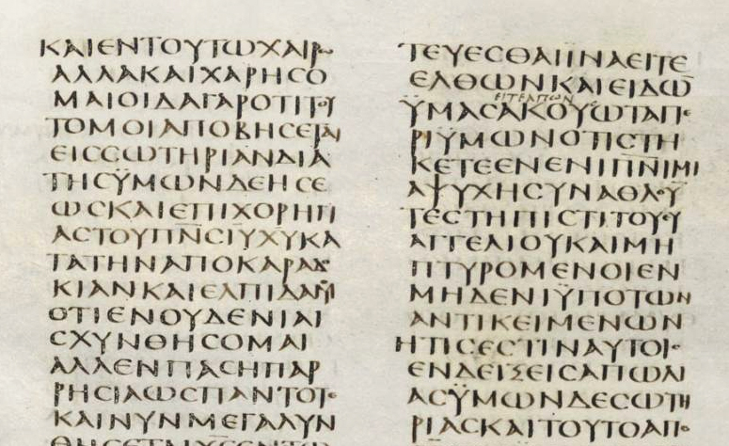
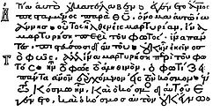
The Manuscripts of the New Testament
2 types of manuscripts (Greek):
uncials: earliest; written in all block capitals
NOWCONCERNINGSPIRITUALGIFTSBROTHERSIDONOTWANTYOUTOBEUNINFORMED
minuscules: beginning ~ 800’s AD; cursive

Slide 7
“…the best-attested book from the ancient world.”
5,400 Greek manuscripts – mostly fragments, only a few contain whole New Testament
650 are uncials; about 50 date from 100’s – 300’s AD
2nd best attested – Homer’s Iliad (900 BC) – 653 manuscripts; earliest complete text – 1200’s AD (earliest fragment – 400 BC)
Other witnesses: Lectionaries (for worship); early translations (Syriac, Coptic, Old Latin, Vulgate); early church fathers
Bruce Metzger – “Indeed, so extensive are these citations [of early church writers] that if all the other sources for our knowledge of the text of the New Testament were destroyed, they would be sufficient alone for the reconstruction of practically the entire New Testament.”

Slide 8
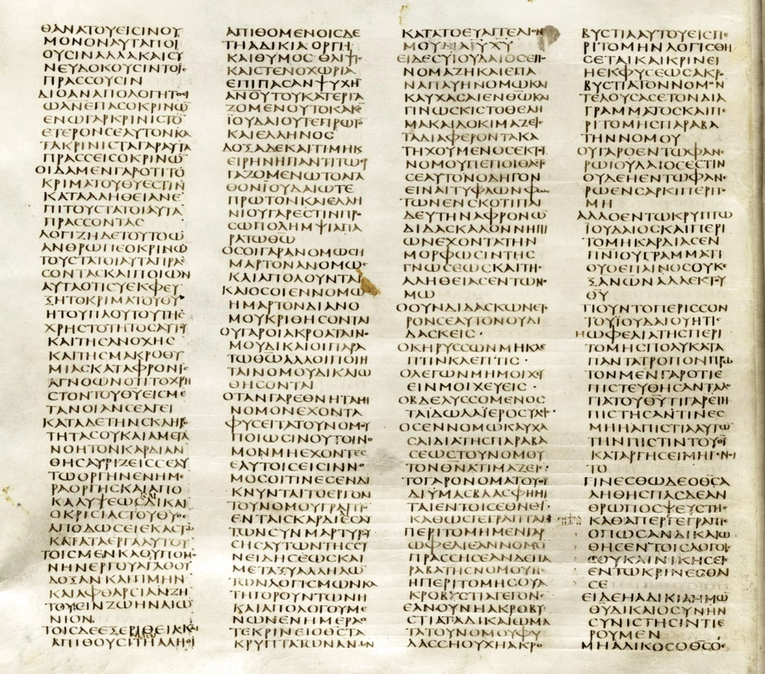
Most Important Uncials
The Vatican Manuscript
vellum codex from the 300’s AD
all of OT & NT except most of Genesis, 33 Psalms, end of Hebrews, letters to Timothy & Titus; Revelation
The Sinaitic Manuscript
also from the 300’s AD
some of the OT, but a complete text of the NT (earliest)
The Alexandrian Manuscript
from the 400’s AD; 1st of the three great uncials to come to light
missing several verses in Genesis and I Samuel; most of Matthew and II Corinthians; a few chapters in John
These form the foundation of the New Testament text
The Sinaitic Manuscript

Slide 9
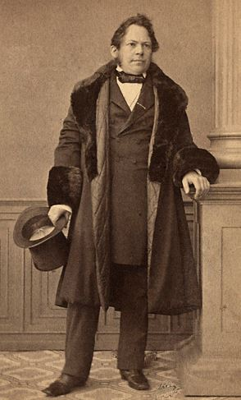
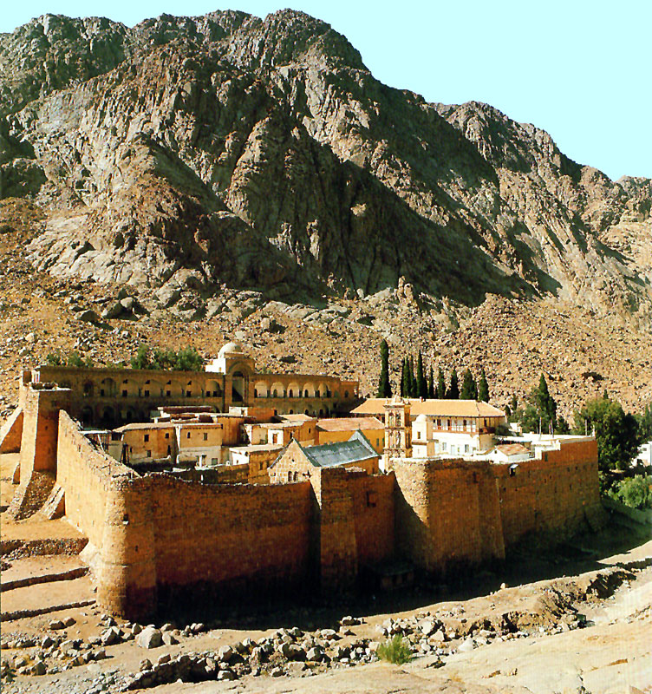
Constantin Tischendorf 1815-1874
Biblical scholar, University of Leipzig; searched the world for best NT manuscripts
studied the Vatican Manuscript and published an edition of it in 1867
1844 – he discovered the Sinaitic Manuscript at St. Catherine’s Monastery at Mt. Sinai; published it in 1862

Slide 10
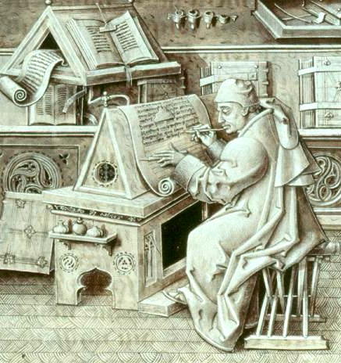
Textual Criticism
“…the textual critic… seeks by comparison and study to recover the exact words of the author’s original composition.”
Copyist mistakes:
Unintentional errors
spelling mistakes (or changes over time); inverted or repeated words; skipped words or lines
Intentional errors – attempts to correct what appears to be an error
“…as yet the Spirit had not been given, because Jesus was not yet glorified” – lit., “not yet was the Spirit”

Slide 11
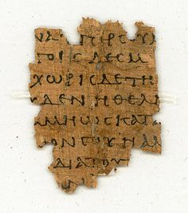
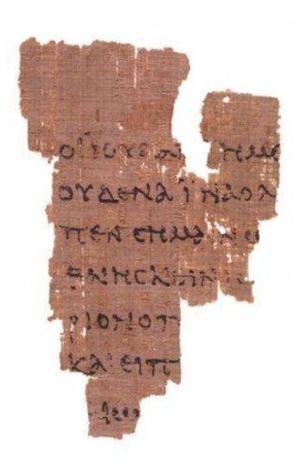
Some Rules for Textual Criticism
The more difficult reading is preferred
The quality of textual witnesses is more important than the quantity of witnesses
In parallel texts, different readings are usually preferred
Example: “But I say to you that everyone who is angry with his brother [without cause] will be liable to judgment…”
Matthew 5:22

Slide 12
Textual Variations in Manuscripts
200,000 or more copyist errors among the 5,400 manuscripts
if the same mistake occurs in 4,000 different manuscripts, that counts as 4,000 errors
Errors aren’t widely, randomly distributed – they tend to cluster around the same few texts
“If the large number of manuscripts increases the total of variations, at the same time it supplies the means of checking them.”

Slide 13
Examples of Substantial Variations
John 7:53-8:11 – woman caught in adultery
appears in only one early manuscript from the 400’s AD, which contains a number of odd additions to the text; rest of the manuscript evidence comes from after 700’s AD ; probably a tradition handed down from early church
I John 5:7 – “ For there are three that bear record in heaven, the Father, the Word, and the Holy Ghost: and these three are one.” (KJV)
appears in only 2 manuscripts, one from the 1400’s and another from the 1500’s
Mark 16:9-20 – post-resurrection appearances of Christ
alternate shorter ending – supported by only a few manuscripts
Vatican and Sinaitic Manuscripts do not have vss. 9-20; writing is different and transitions are awkward (e.g., Mary Magdalene’s introduction in vs. 9)
however, Alexandrian Manuscript, several other early uncials, and all late uncials and miniscules include it
“Except for a few instances, we have an unquestioned text; and even then not one principle of faith or command of the Lord is involved.”

Slide 14
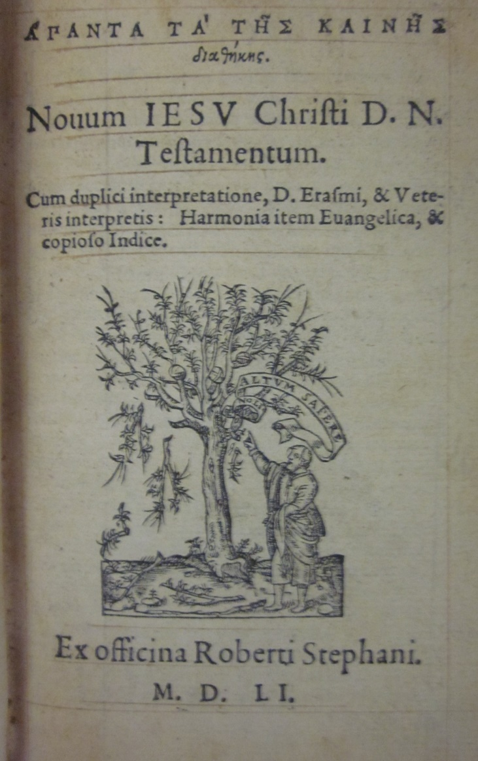
The Restored Greek Text
1516 – Erasmus edited and published first printed Greek New Testament
1550 – Robert Estienne (Stephanus) publishes an improved edition of the Greek NT – basis for the translation of the KJV – later called the “Received Text” or “Textus Receptus”
1627 – Alexandrian Manuscript discovered – copied 700 years earlier than manuscripts used by Erasmus and Estienne

Slide 15
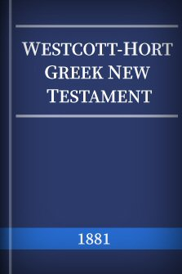
The Westcott-Hort Text
mid-1800’s – Tischendorf discovers the Sinaitic Manuscript and publishes the Vatican Manuscript
1881 – after 30 years of work, Brooke Westcott and Fenton Hort publish The New Testament in the Original Greek, along with notes on variations and principles of textual criticism
Westcott and Hort: “…doubtful textual variants exist only in one sixtieth of the whole New Testament (with most of them being comparatively trivial variations), with the substantial variations forming hardly more than one thousandth of the entire text.”
Dr. Daniel Wallace: “…over 98% of the time, the Textus Receptus and the standard critical editions agree”

Slide 16
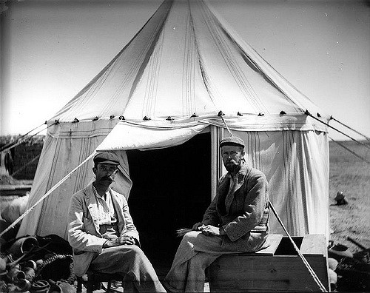
New Testament Papyri
1897 – B.P. Grenfell and A.S. Hunt find a deposit of papyri in the sands of Egypt, including many fragments of the NT, some of them dating back to the 100’s AD – 300’s AD
1900’s – more papyri are discovered – about 100 total – more than 30 are from the 100’s and 200’s AD; at least one (fragment of John) is from early 100’s AD
P⁷⁵ – most of Luke & John – dated in late 100’s – virtually the same as Vatican & Sinaitic Manuscripts
Papyri evidence strongly supports Westcott-Hort text

Slide 17
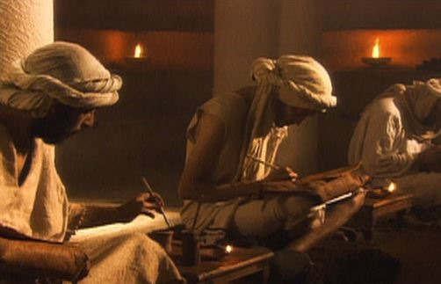
The Old Testament Text
Same principles of textual criticism apply
Textual evidence is much more limited – Earliest manuscripts of Hebrew OT date from late 800’s AD to 1000’s AD
Lack of earlier copies due to “almost superstitious respect for Scripture” – worn out, damaged, or defective copies were given a ceremonial burial or burned
Masoretes (500-900 AD) – scribes committed to preserving the text through copying – “the Massoretic Text”
Many strict regulations and safeguards to avoid mistakes
Devised vowels and accents to preserve pronunciations

Slide 18
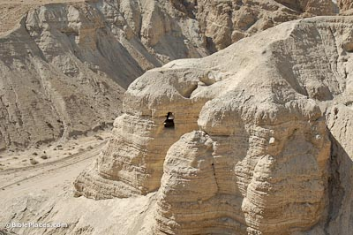
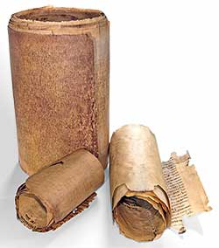
The Dead Sea Scrolls
1948 – Arab shepherd boy discovers ancient manuscripts in cave near the Dead Sea; others later found in areas nearby (Qumran)
Manuscripts date back to 100 BC
Among the scrolls were fragments of almost every book of the Old Testament, including an almost complete copy of the book of Isaiah
copies of Isaiah – 95% word for word (5% typos)
Vast majority of fragments are identical or very close to the Massoretic Text; some are loose paraphrases

Slide 19
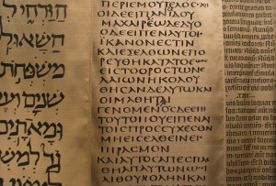
The Septuagint - LXX
legend – King Ptolemy II of Egypt commissioned translation of the Law from Hebrew into Greek – around 250 BC
6 elders from each of 12 Jewish tribes chosen – separated from each other
translation is completed in 72 days – identical translations
rest of OT translated later
a slightly loose translation (dynamic equivalence?); some minor omissions and rearrangements – not as carefully guarded
the OT translation used by the early Church

Slide 20
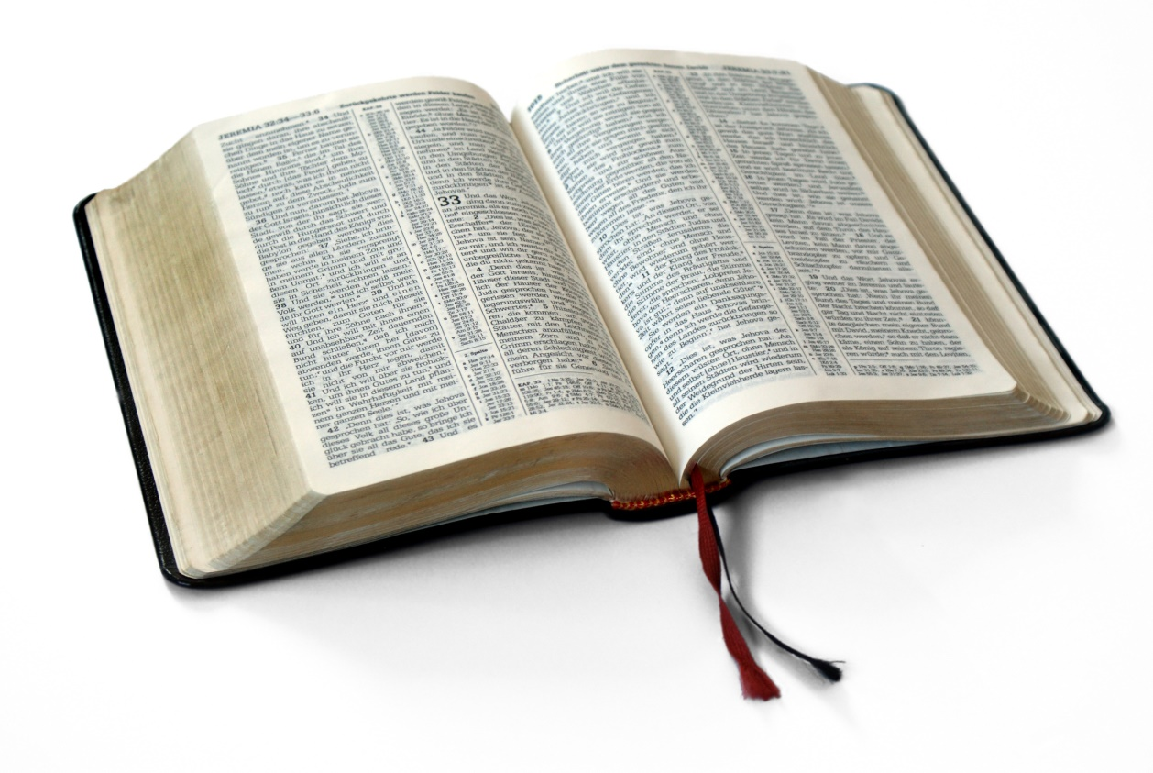
“The Christian can take the whole Bible in his hand and say without fear or hesitation that he holds in it the true Word of God, handed down without essential loss from generation to generation throughout the centuries.”
Sir Frederic Kenyon, Biblical scholar, Director and Principal Librarian, British Museum

