Slide 1
John calvin - The Theologian of the reformation

Slide 2
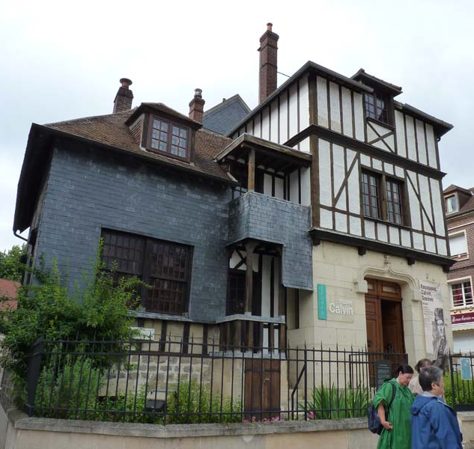
Beginnings
Born in 1509 in Noyon, France (60 miles north of Paris)
Father was an assistant to the bishop – wanted John to become a priest – sent John to Paris to study theology
John abandons theological studies and goes to Orleans to study law
A brilliant student – became enamored with writings of the humanists – Erasmus
A quiet conversion to Reformation teachings – “God by a sudden conversion subdued and brought my mind to a teachable frame.”

Slide 3
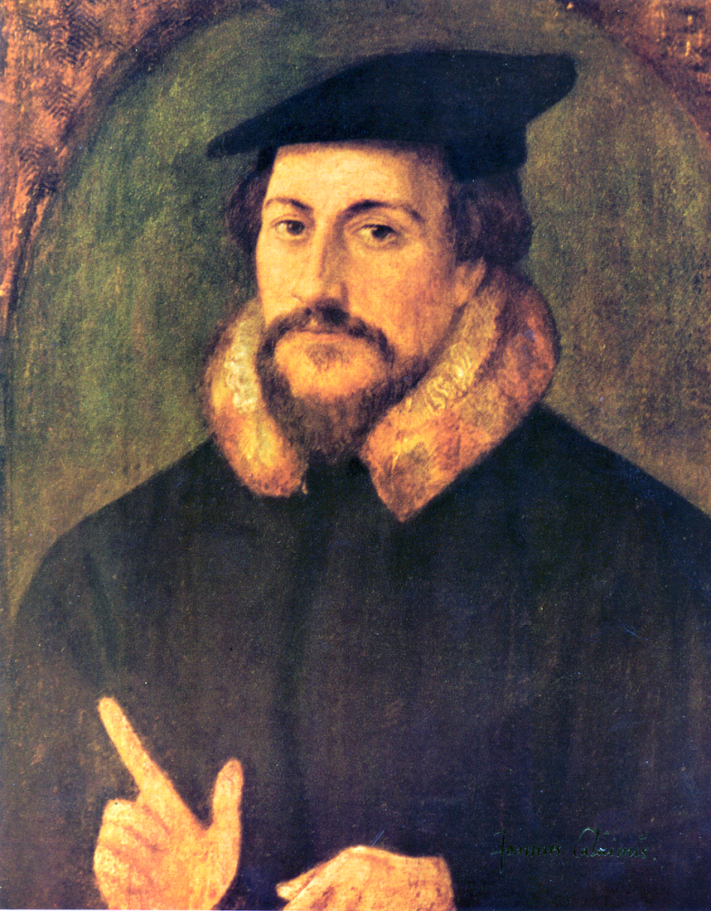
“He was not popular. He was the kind of man who has only disciples or opponents; it was impossible to be neutral about him. He was known and beloved by a few intimates… He was naturally austere, with no pleasure in food or drink; one almost suspects him of marrying to set an example… He had none of Luther’s exuberance and joy in life. There was no abandon, he held himself upon a reign… He was a man of the intellect, a man of doctrine. Not even his intimates could penetrate to his soul… There was something aloof, secret, reserved.”
Owen Chadwick, The Reformation

Slide 4
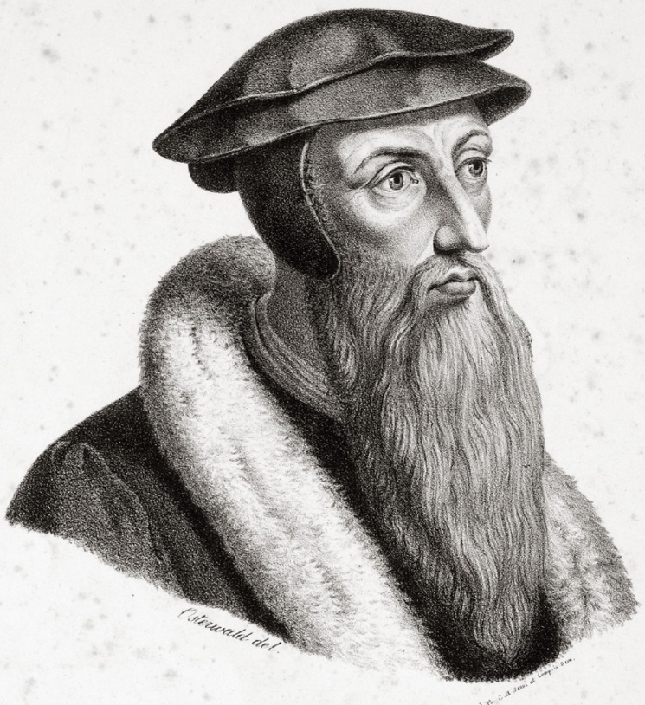
“Where Luther would roar with laughter and gulp his beer, Calvin would much rather have sat quietly with his books. Where Luther was brash and earthy, Calvin was self-composed and (usually) polite… Both wrote huge quantities, but where Luther would fire off books like a semi-automatic in a street fight, Calvin would spend years polishing and repolishing his piece de resistance. Calvin could never have been a celebrity Christian: a camera-shy intellectual, he always avoided the limelight. His portraits show a thin face, that often-throbbing head covered with a simple black cap, and strikingly intense eyes. In that, they are quite revealing, for while pitifully weak in body and naturally retiring by temperment, he was dauntingly strong in both mind and will.”
Michael Reeves, The Unquenchable Flame

Slide 5
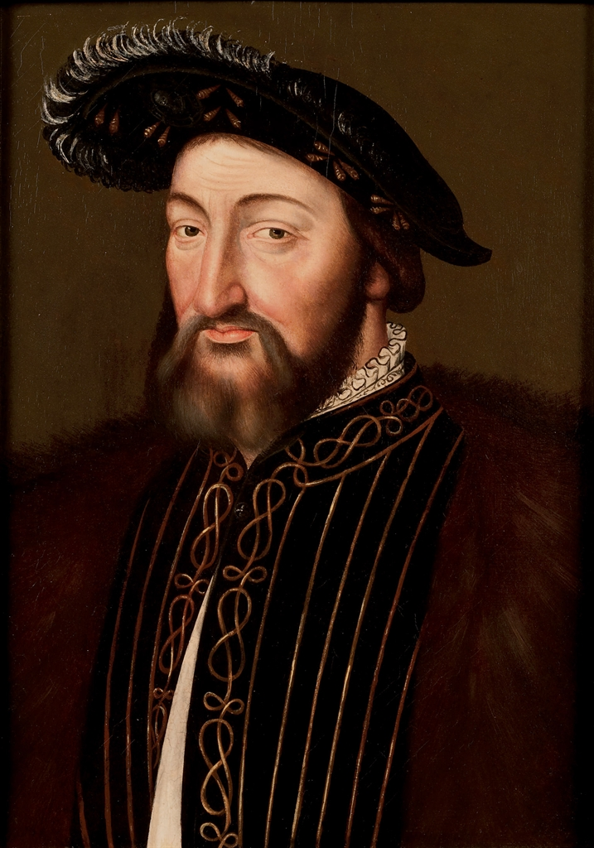
Persecution in France
King Francis I – moderate; initially protects those with reforming ideas
1528 - decapitation of statue of Virgin Mary – persecution of protestants begins
1534 – The Placard Campaign increases the heat on reformers
Calvin flees to Basel, Switzerland with others

Slide 6
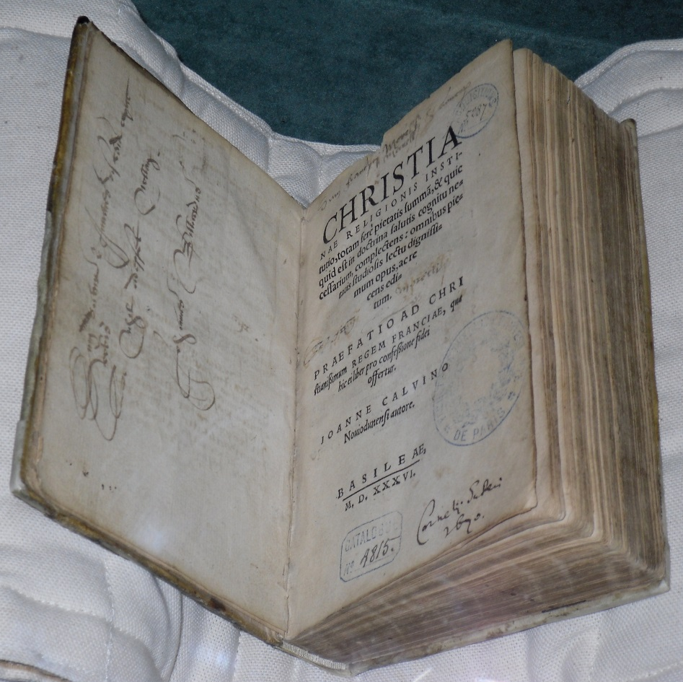
The Road to Geneva
In Basel (1535) – Calvin writes the first edition of The Institutes of the Christian Religion at the age of 26 – “basic instruction” in the essentials of Reformation theology – Apostles’ Creed
Wants to go to Strasbourg, France to pursue studies in theology – blocked by a war on the way – takes detour through Geneva, Switzerland
William Farel challenges Calvin to stay in Geneva to establish Reformed teaching – “May God condemn your repose, and the calm that you seek for study, if before such a great need you withdraw…”

Slide 7
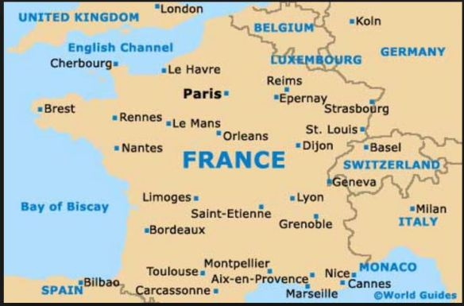

Slide 8
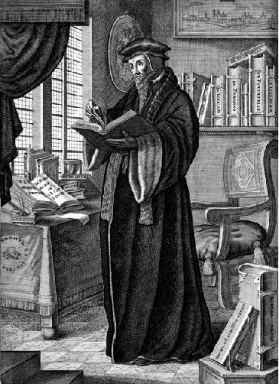
A Respite in Strasbourg
Calvin’s and Farel’s reforms eventually alienate citizens and magistrates – asked to leave
Calvin goes to Strasbourg – Martin Bucer persuades him to become pastor of French Protestant refugees
Happiest period of Calvin’s life – teaching, preaching, writing; marries Idelette, a widow and former Anabaptist

Slide 9
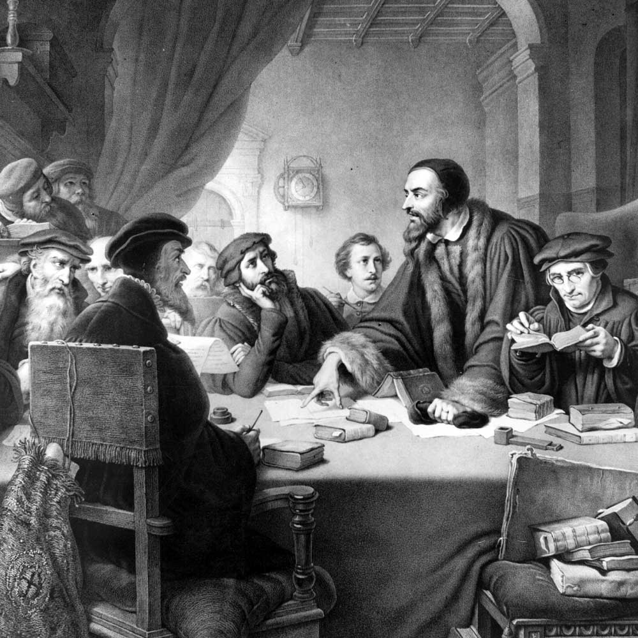
Back to Geneva
1541 – Geneva, after a period of turmoil, pleads with Calvin to return and bring order to the church and city
Calvin submits plans for reform to the city magistrates
Sets up “consistory” – 5 pastors, 12 elders; also deacons to serve needs
Disciplinary committee – oversaw the morals of the city – actions resented by many
Many French Protestant refugees flock to Geneva

Slide 10
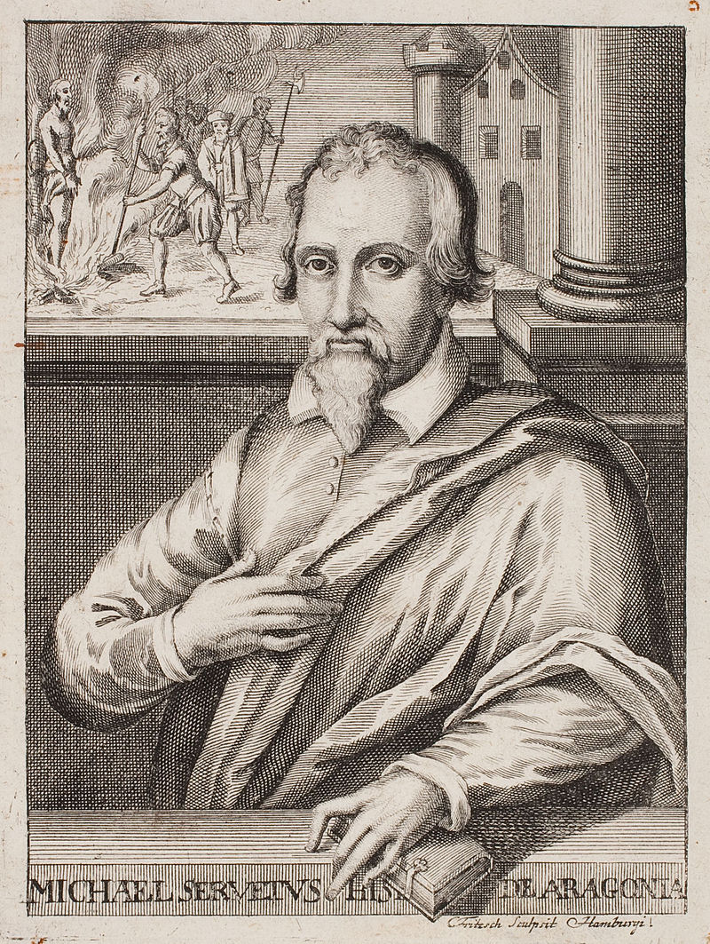
The Servetus Incident
A Spanish heretic – denied the Trinity, atonement
Escaped Catholic prison after being condemned to death by The Inquisition
Goes to Geneva to provoke a confrontation with Calvin
City magistrates sentence him to death by burning at the stake
Calvin approved, as did most of the other Protestant leaders in Europe

Slide 11
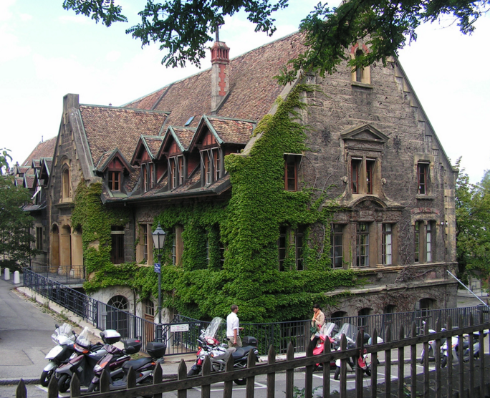
The Geneva Academy
Calvin becomes “leader-in-exile” of French Protestant movement – works with underground churches; network of safe houses; spreads Reformed doctrines – 10% of French population
The Geneva Academy - established in 1559 – trained pastors and leaders for all over Europe – led by Theodore Beza
John Knox – “The most perfect school of Christ that ever was in the earth since the days of the Apostles”

Slide 12
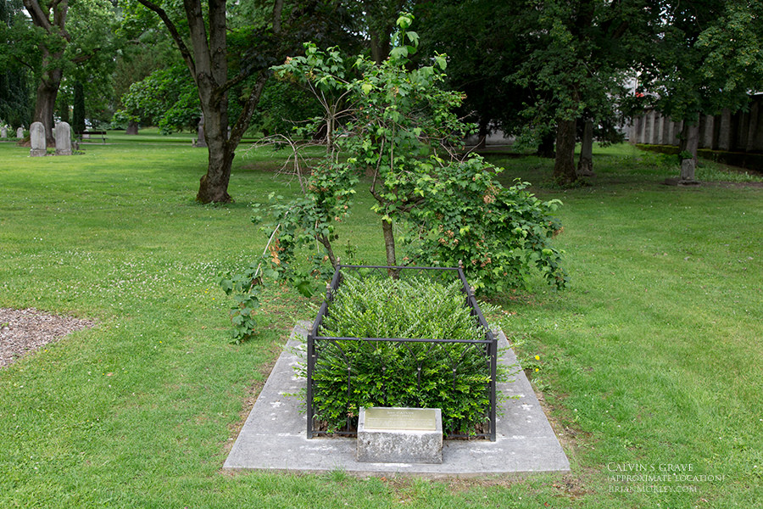
End of Calvin’s Life
“…Calvin quite deliberately turned Geneva into an international center for the propagation of the Gospel. He advised Protestant rulers from Scotland to Italy, trained refugees who came to Geneva and then returned to their native countries , and dispatched missionaries to Poland, Hungary, the Netherlands, Italy, even South America.” Michael Reeves, The Unquenchable Flame
Finished The Institutes (1559), wrote commentaries
1555-1564 – Calvin’s health deteriorates; buried in an unmarked grave

Slide 13
Calvin’s Theology
Intellectual, logical, systematic, warm
Calvin hated the word “Calvinism”
Didn’t stress predestination – wasn’t an issue until the rise of Arminianism in the next century (election isn’t addressed until 2/3rds of the way through The Institutes)
Emphasized God’s glory, grace, sovereignty, and providence

