Slide 1
The Reformation of the Church

Slide 2
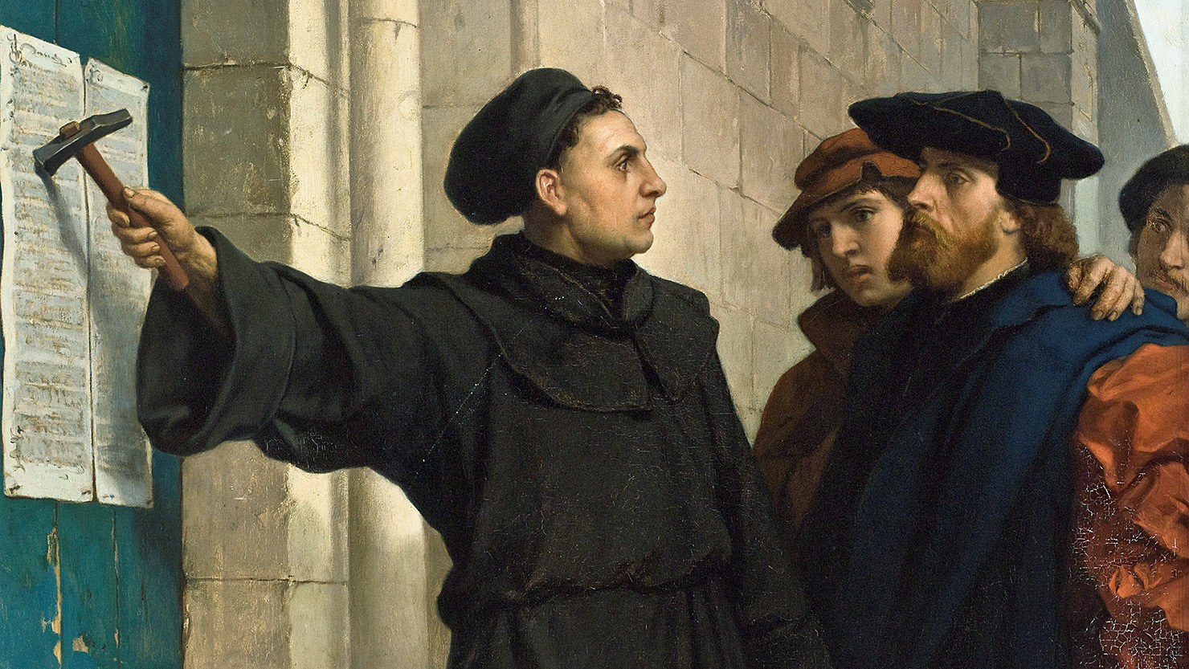
“It only takes a spark…”

Slide 3
Conditions Ripe for a Wildfire Movement
Corruption in Church Leadership:
Untrained Priests
Immoral Priests
Simony
Pluralism
Absenteeism
“Right of Clergy”
Erasmus (1502) – “…a layperson is insulted unpardonably if he is called a cleric, priest, or monk.”

Slide 4
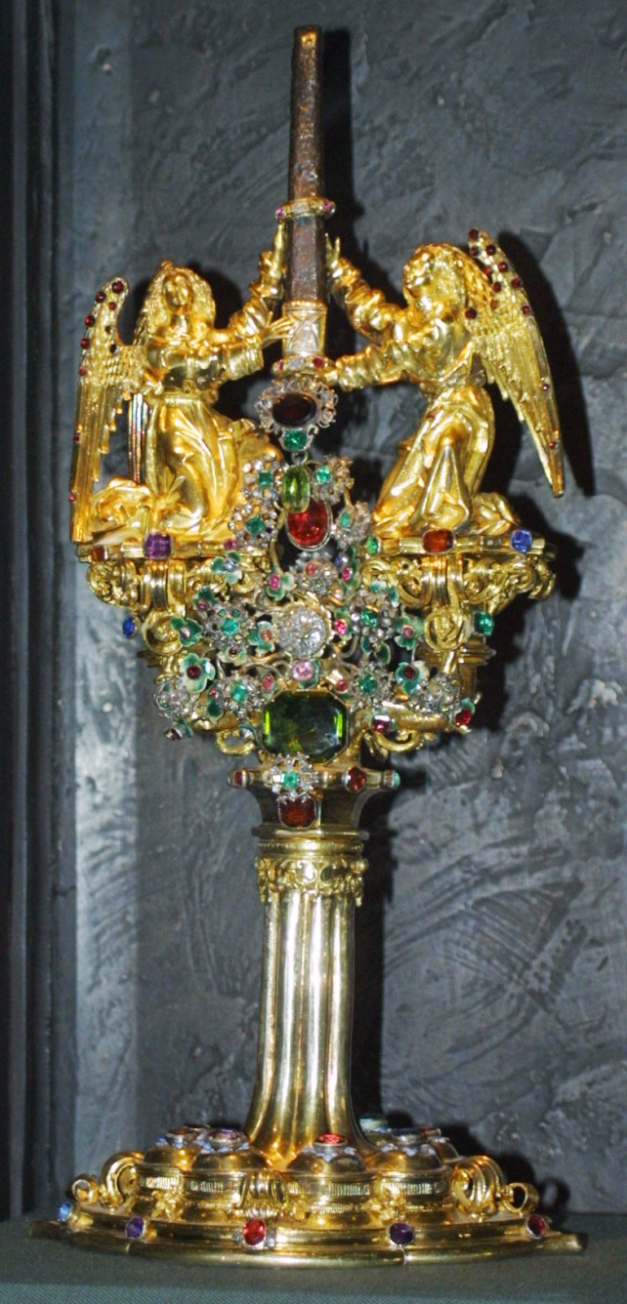
Corruption of Worship and Service:
Latin Mass
Veneration of Mary & the saints
Purgatory & the “Treasury of Merit”
Confession & penance
Dispensations
Indulgences
Relics
Owen Chadwick: “When churchmen spoke of reformation, they were almost always thinking of administrative, legal, or moral reformation; hardly ever of doctrinal reformation.”

Slide 5
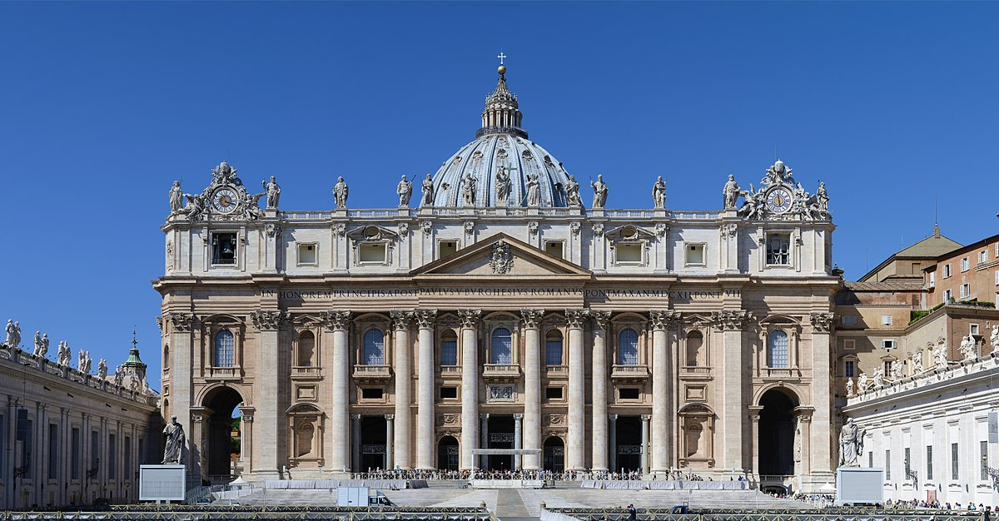
Chaos in the Papacy:
1054 AD – split with Orthodox Church
Late 1300’s – three popes at once – resolved in 1418
The decay and rebuilding of Rome
The partying pope, the war-mongering pope, the agnostic pope
Debunking of “The Donation of Constantine”
Conflict between popes and cardinals

Slide 6
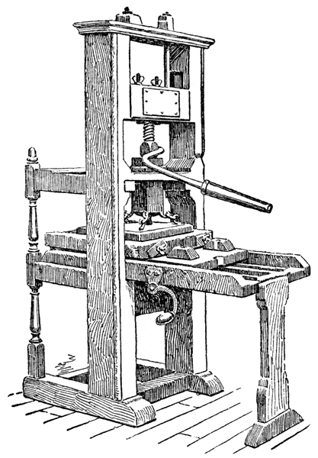
Changes in the Broader Culture:
The decline of “Christendom” & papal power over the state, and the rise of nationalism & the power of kings
Reformers often looked to civil government for help against the power of Rome
The Renaissance & humanism
Rediscovery of Classical (Greek/Roman) architecture, literature, philosophy, art
Greater commerce and wealth
The printing press (1450) & “broadsides”

Slide 7
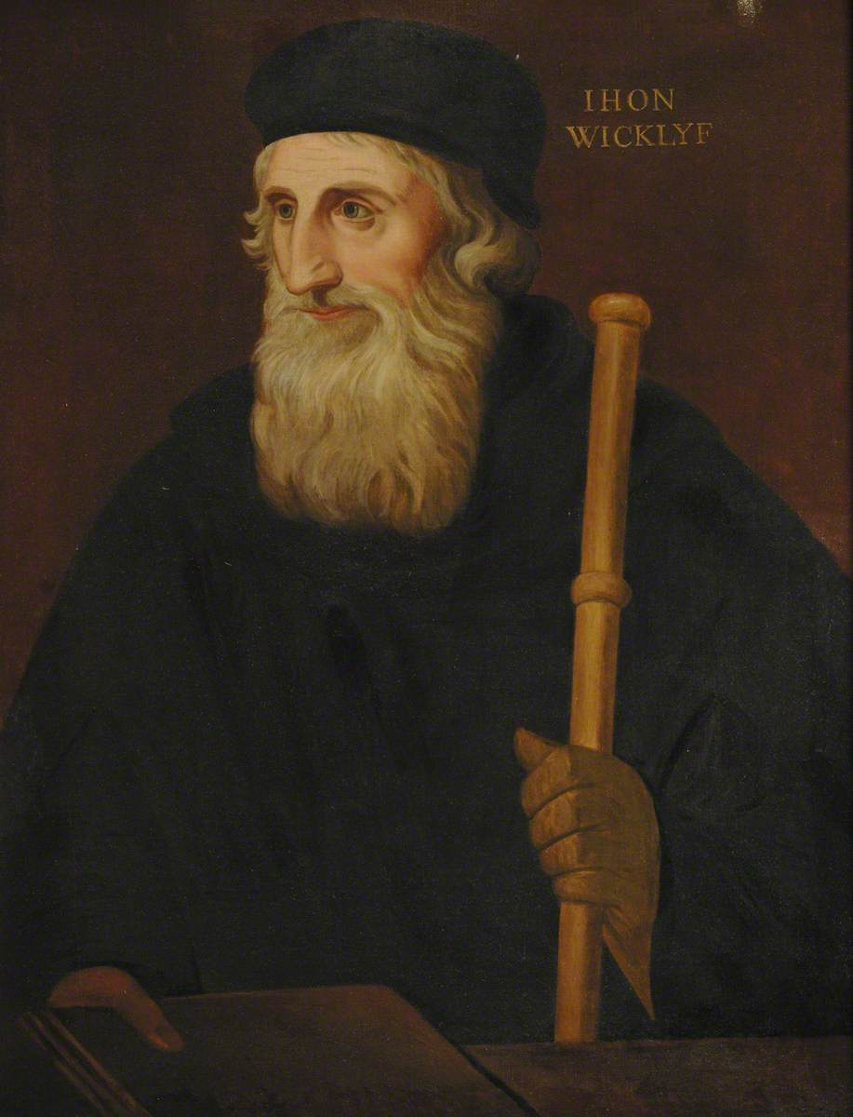
Forerunners of the Reformation
Waldensians – started in 1173 - Lyons, France
Rejected the papacy, transubstantiation, purgatory
John Wycliffe (1320’s – 1384)
Priest, scholar, writer – Oxford, England
Bible is the supreme authority, not the Pope
Rejected transubstantiation
Had Latin Vulgate translated into English
Died before condemned as a heretic
Followers called “Lollards” – secret Bible studies

Slide 8
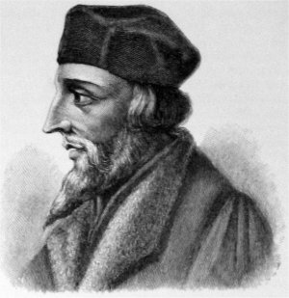
Jan Hus (1369 - 1415)
Priest, scholar, university rector – Prague, Bohemia (Czech Republic)
Heard students of Wycliffe and championed his teachings in Bohemia
Excommunicated and martyred
Followers known as “Hussites” - won religious freedom against papal crusades
“You may roast this goose, but a hundred years from now a swan will arise whose singing you will not be able to silence.”

Slide 9
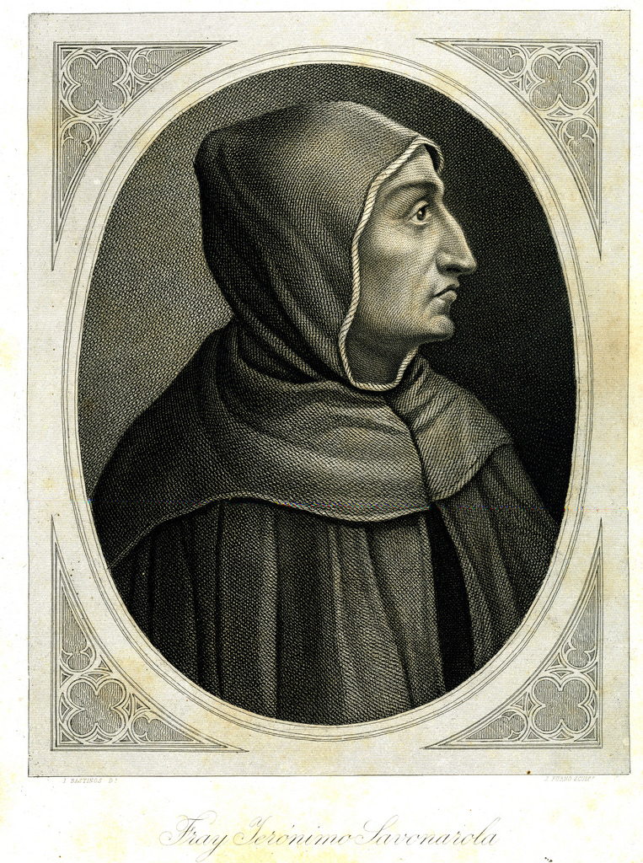
Savonarola (1452 – 1498)
Dominican friar, preacher in Florence, Italy
Called for reform and renewal; denounced corruption in the church; led city-wide revival and destruction of secular art; defied pope’s authority
Excommunicated; hanged by civil authorities

Slide 10
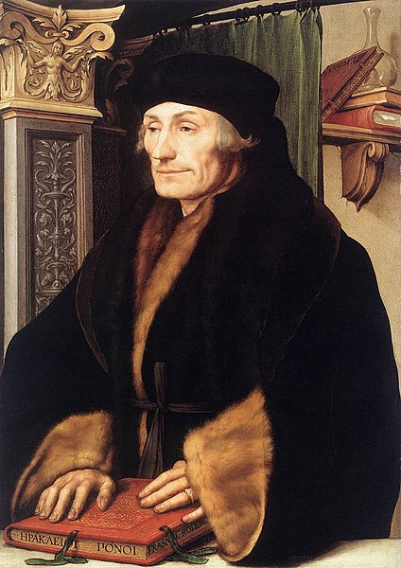
Erasmus (1466 - 1536)
Scholar, priest, writer, satirist, critic of church & state
Very widely read throughout Europe
Produced a new translation of the New Testament using manuscripts (addition to the Latin Vulgate used by the church)
Rejected Luther’s theology and remained part of the Catholic Church

Slide 11
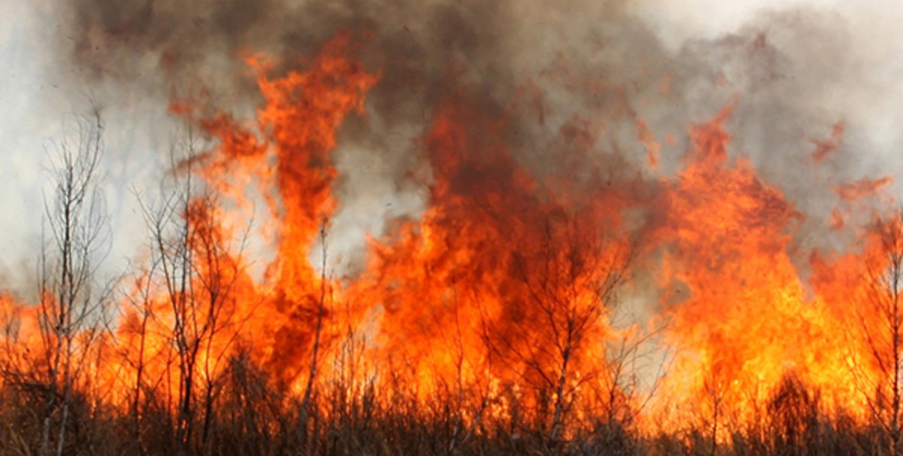
“Europe wanted reform, and was not expecting revolution.
Like Erasmus, many educated men would have preferred the Church to be ridiculed into good sense and efficiency and purity of life. But a man who is holding property will not be mocked out of it… There was a celebrated saying of the sixteenth century: ‘Erasmus laid the egg and Luther hatched it.’ It is certain, at least, that Erasmus alone would not, and could not, have hatched it. He afterwards said that he would have written his books otherwise if he had foreseen what was coming.”
Owen Chadwick

