Slide 1
Building Project, Budget & Finance Update
July 23, 2017

Slide 2
Growing roots…bearing fruit… branching out

Slide 3
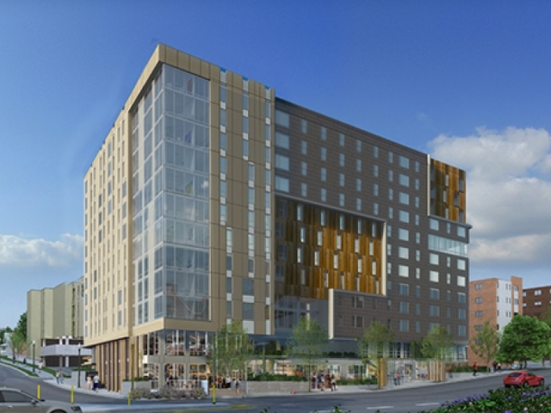
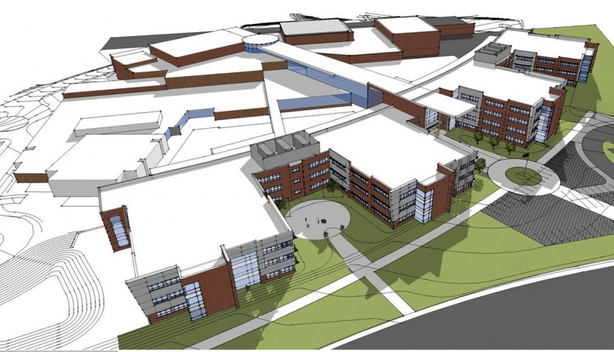
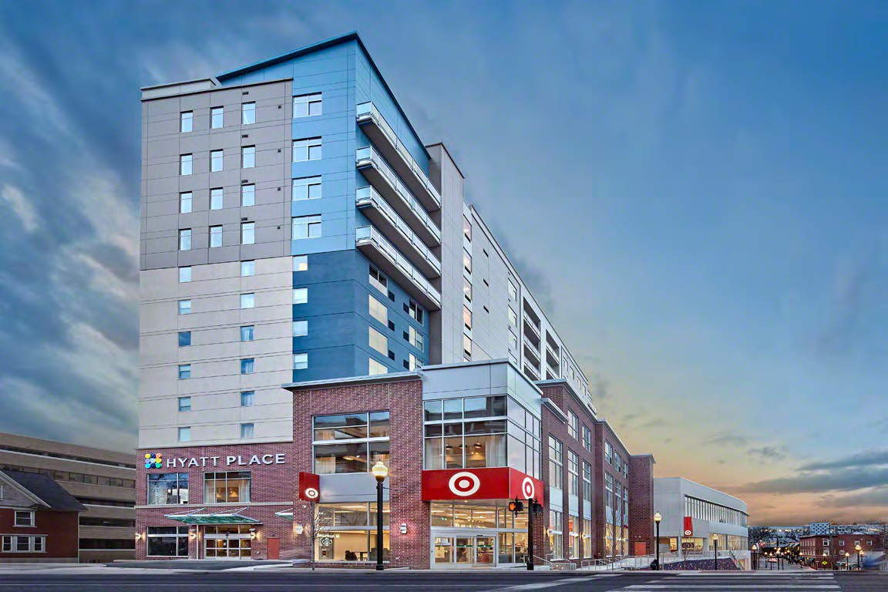

Slide 4
Kingdom Building
“The master commended the dishonest manager for his shrewdness. For the sons of this world are more shrewd in dealing with their own generation than the sons of light. And I tell you, make friends for yourselves by means of unrighteous wealth, so that when it fails they may receive you into the eternal dwellings.”
Luke 16:8-9

Slide 5
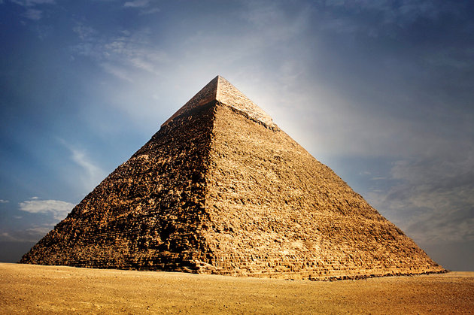
Supporting the Growth

Slide 6
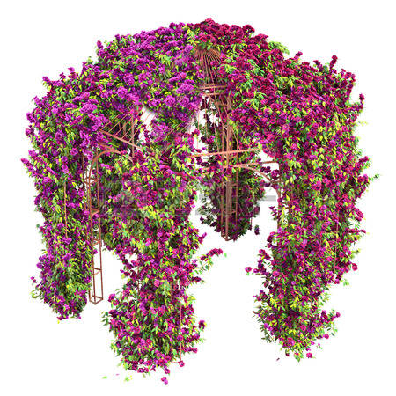
The Overgrown Trellis
“I am the vine; you are the branches. Whoever abides in Me and I in Him, he it is that bears much fruit, for apart from Me you can do nothing.” John 15:5

Slide 7
Facilitating Further Growth
Classrooms for Sunday School, Meetings, Ministries
More and Better Worship Space
More and Better Nursery Space
More Before- and After-Service Gathering Space
More and Better Office Space
More and Better Bathroom Space

Slide 8
Transition Team Vision
"By God’s grace, the Transition Team desires to construct a trellis that honors the core ministry values of Oakwood, in order to unleash opportunities for the future growth of God’s vineyard."

Slide 9
Transition Team Process
8 Months, 42 Meetings, 135 Hours…so far. ☺
Ministry Leaders/Committee Meetings/Staff & Officers
Congregation Survey & Newsletter Updates
Congregational Presentations: Dec. 7, Feb. 10, March 2
Design-Build Team (Poole Anderson & Hoffman/Leakey) Meetings

Slide 10
Current Property

Slide 11
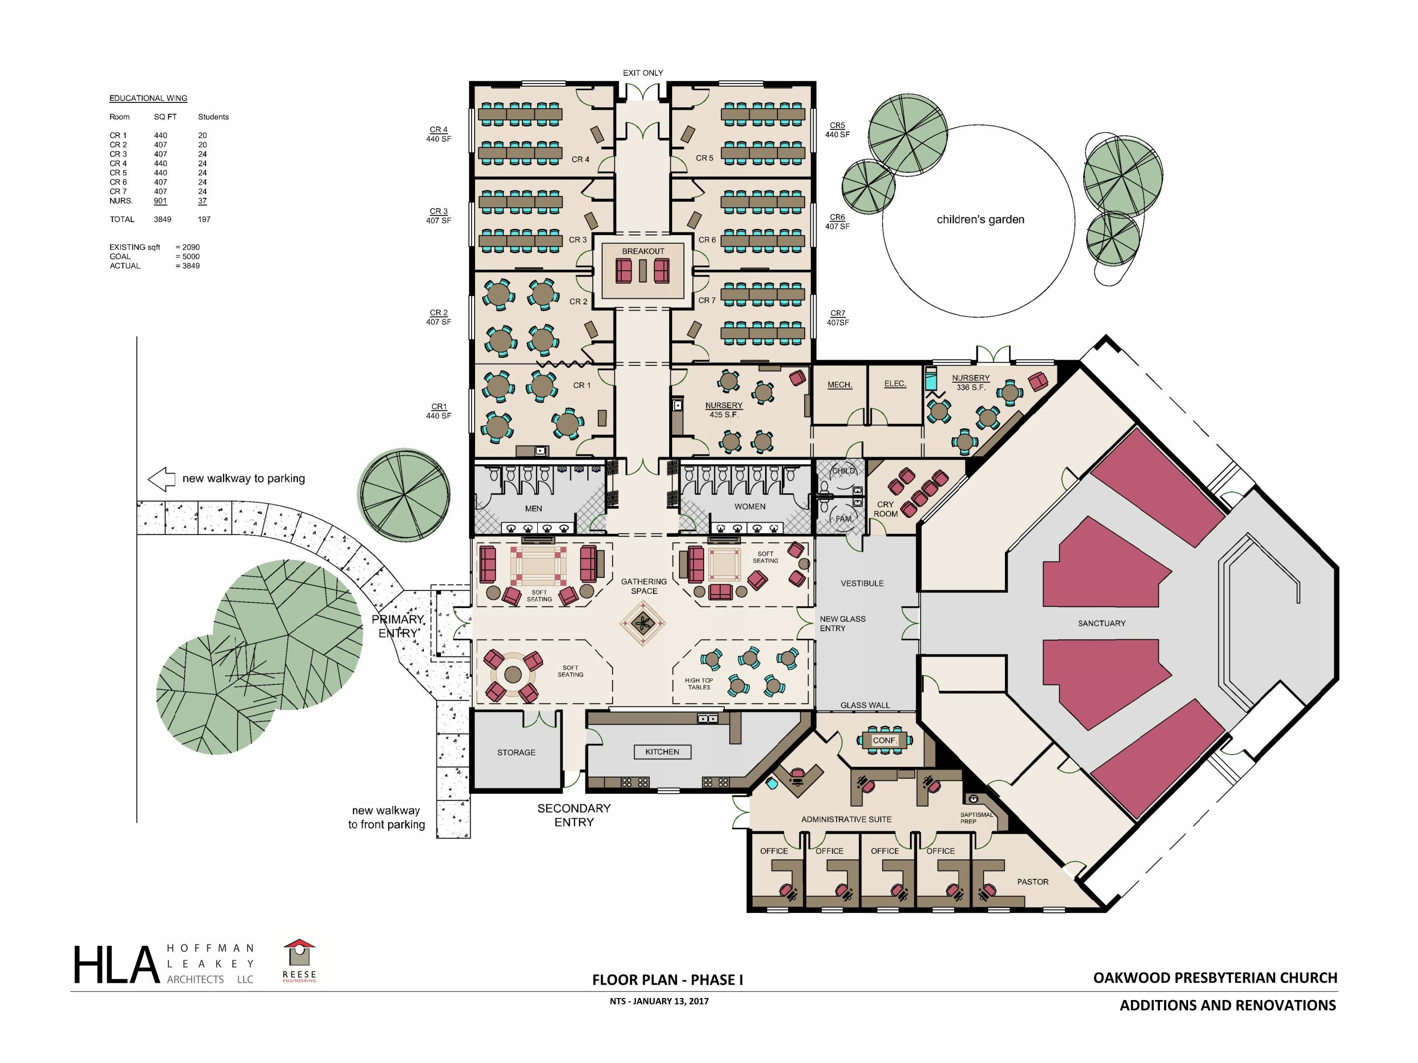
Project Scope
Gathering Space (kitchen)
Classrooms
Bathrooms
Nursery
Minor Sanctuary Improvements
New Entranceway
Offices

Slide 12
Project Scope “A finished building.”
Congregational Feedback
Gathering Space
New Entranceway
New Kitchen
12 Classrooms
Larger Nursery (26%)
Sanctuary Improvements
Offices
Project Cost $3 Million

Slide 13
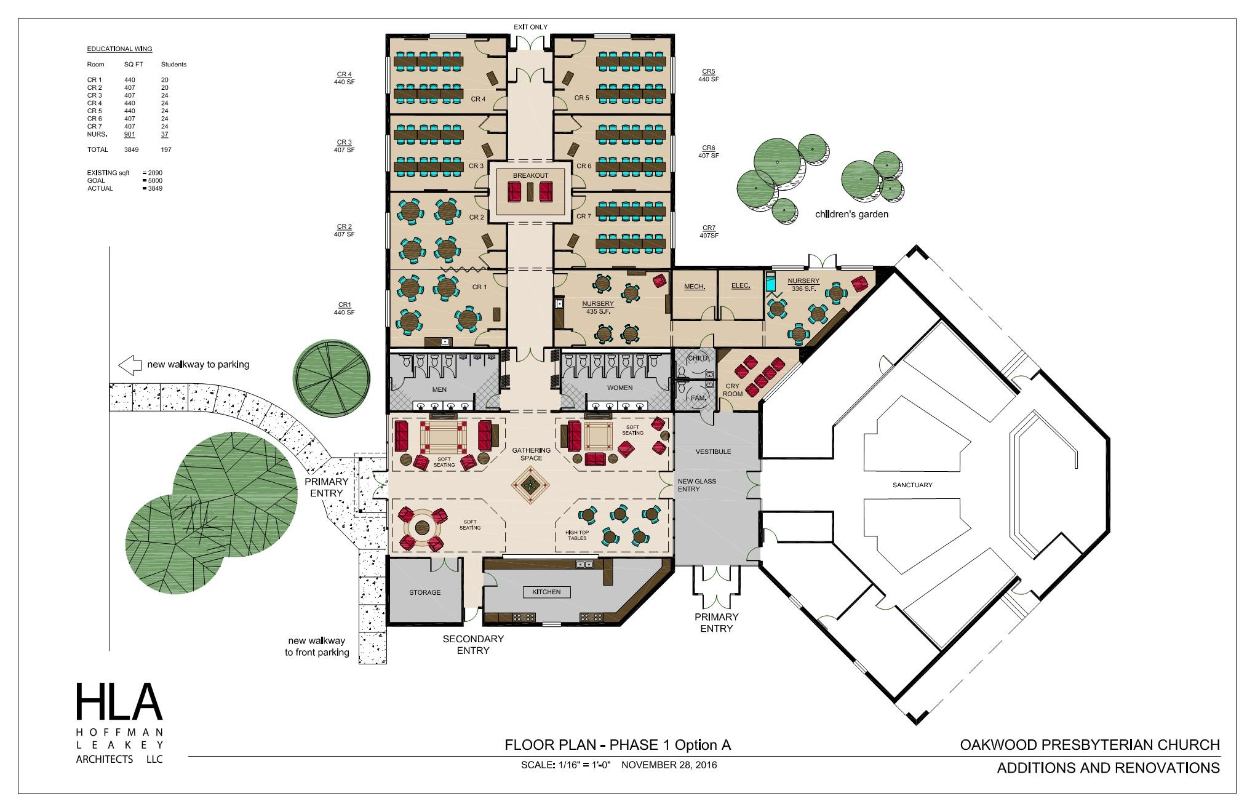
Reduce Scope & Cost
Offices (relocate or rent)
No Adjustments to Kitchen or Sanctuary
Minimal Adjustments to Gathering Space & Entranceway
Budget Points:
$1.75M
$2.25M
$2.5M

Slide 14
Reduce Scope & Cost
Eliminate Offices ($275,000 Savings)
Less Classrooms
Rental Cost ($1,650 Month)
$19,800 Year & $99,000 (5 Years)
Project Cost
3-5% Increase Project Cost Annually
$44,000-76,000 Increase (5 Years)
$350,000 (5 Years)
Challenges for Staff

Slide 15
Final Project Scope “A finished building.”
Reusing Existing Mechanical Space
Stacking Bathrooms
Reducing Classrooms to 11
Removing Nursery Bathroom
Reducing Lobby Doorways
Finishes (flooring)

Slide 16
Final Project Scope “A finished building.”
Gathering Space
New Entranceway
New Kitchen
Offices
Sanctuary Improvements
Relocating the Exterior Walls
Adding Windows-Exterior Walls
Demolishing Interior Walls
New Flooring
Improved Lighting
Project Cost $2.5 Million

Slide 17
Next Step?
Recommended by Officers (Elders & Deacons)
Larger Long-Term Mortgage
Transition Team Endorsement
Finance & Fundraising Committee Reports
Congregational Vote on the Recommendation on August 6 @ 7:00pm

Slide 18
Trellis Financial Report: 7/23/17
1) Fundraising Report
2) Budget Projections
3) Financial Forecast
4) Payoff Picture

Slide 19
Trellis Financial Report: 7/23/17
1) Fundraising Report (current)
3-Year Pledges = $750,000
2020-2026 Pledges = $300,000
Donations since start of campaign = $297,600
Pledge & Giving Participation = 62 Families
Median 3-Year Pledge = $1,740 per year
(factor for giving estimates from new members between now and 2024)

Slide 20
Trellis Financial Report: 7/23/17
2) Budget Projections:
Only two (but significant) changes since fall 2016 projections:
1) 2017 budget is $16,000 less than fall expectation.
2) 2018 building completion starts growth and eliminates office rent a year sooner.

Slide 21
Trellis Financial Report: 7/23/17
2) Budget Projections:
Average surplus estimate 2019-2024 is $60,000 annually.

Slide 22
Trellis Financial Report: 7/23/17
2) Budget Projections:
Average surplus estimate 2019-2024 is $60,000 annually:
A) Allows for moderate budget increases for needs of current ministries.
B) Allows for staffing increase(s) when average attendance exceeds 400.
C) Accounts for 10% increase to building costs for larger facility.
D) Projected growth rates are consistent with growth after change to two services and when Pastor Kiehl arrived.

Slide 23
Trellis Financial Report: 7/23/17
3) Financial Forecast by Year
Cumulative estimated trellis giving based on three factors:
1) Pledges fulfilled (plan for 70% post-2019)
2) Budget surplus (plan for 80% of projected growth)
3) Giving after pledges (need 55% of 3-year pledges)
2017: $934,000 2022: $2.02 million
2018: $1.18 million 2023: $2.22 million
2019: $1.46 million 2024: $2.39 million
2020: $1.63 million 2025: $2.57 million
2021: $1.82 million 2026: $2.75 million

Slide 24
Trellis Financial Report: 7/23/17
4) Payoff Picture for $2.5 million project total
March: we hope to have raised $1.1 million in total trellis giving. (Currently ~$819,000)
August, 2018: We would begin to draw on construction loan.
January, 2019: Mortgage would begin with balance of ~$1.26 million.
Minimum monthly payment would be ~$8,280 supposing a 5% interest rate, 30% below most conservative trellis giving estimates. (3-year pledges still coming in through 2019.)
March, 2027 (9 years from ground breaking): Projected payoff date with total interest paid on loan of ~$292,800.
Every additional $50,000 raised before March 2018 reduces loan repayment by ~4 months and saves ~$26,000 in interest.

Slide 25
Next Step?
Email Questions to Pastor Kiehl, Conal Carr and/or Mike Sunderland
Presentation Posted on Webpage
Congregational Vote on the Recommendation on August 6 @ 7:00pm

Slide 26
Building Project, Budget & Finance Update
July 23, 2017

