Slide 1
Creation, Fall, Redemption & Restoration

Slide 2
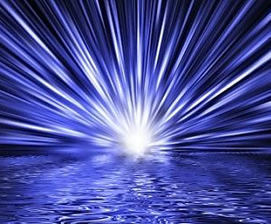
“In the Beginning…”
“And God said, ‘Let there be light,’ and there was light.” Genesis 1:3
“By the Word of the Lord the heavens were made, and by the breath of His mouth all their host.” Psalm 33:6
“By faith we understand that the universe was created by the Word of God, so that what is seen was not made out of things that are visible.” Hebrews 11:3

Slide 3
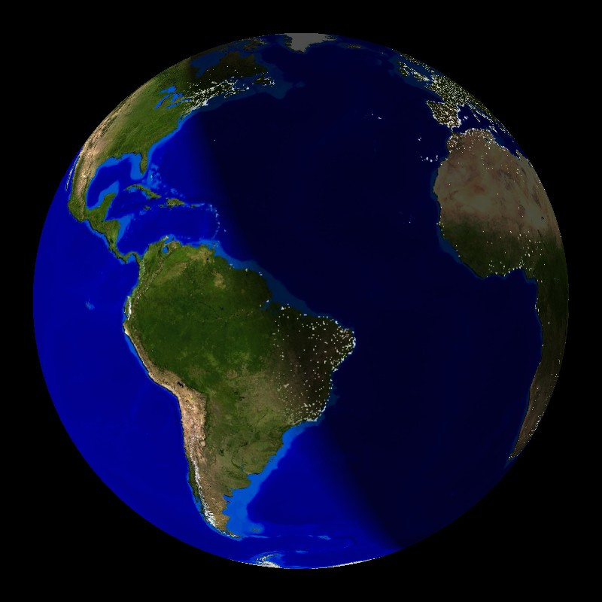
The Days of Creation
“yom” – almost always means either a 24-hr. day or the counterpart to “night”; rarely used in a figurative way (“Day of the Lord”), and context makes it clear
Immediate context: “there was evening, and there was morning…”
“Let there be lights in the expanse of the heavens to separate the day from the night. And let them be for signs and for seasons, for days and years.” Genesis 1:14

Slide 4
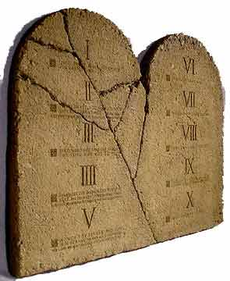
God’s Work Week
“Remember the Sabbath day, to keep it holy… For in six days the Lord made heaven and earth, the sea, and all that is in them, and rested on the seventh day. Therefore the Lord blessed the Sabbath day and made it holy.” Exodus 20:11

Slide 5
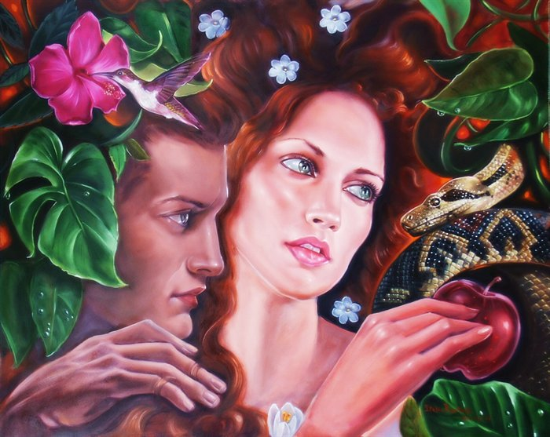
The Historicity of Adam and Eve
“For if, because of one man's trespass, death reigned through that one man, much more will those who receive the abundance of grace and the free gift of righteousness reign in life through the one man Jesus Christ.” Romans 5:17

Slide 6
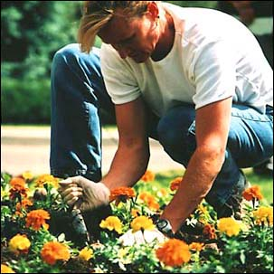
The Dominion Mandate
“So God created man in His image… And God blessed them, “Be fruitful and multiply and fill the earth and subdue it, and have dominion…” Genesis 1:27,28
“And the Lord God commanded the man, saying, “You may surely eat of every tree of the garden, but of the tree of the knowledge of good and evil you shall not eat, for in the day that you eat of it you shall surely die.” Genesis 2:16,17

Slide 7
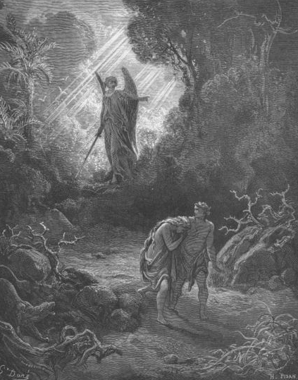
The Fall
“Our first parents, being seduced by the subtlety and temptation of Satan, sinned, in eating the forbidden fruit… By this sin they fell from their original righteousness and communion with God, and so became dead in sin, and wholly defiled in all the parts and faculties of soul and body… They being the root of all mankind, the guilt of this sin was imputed; and the same death in sin, and corrupted nature, conveyed to all their posterity descending from them by ordinary generation…” WCF, Ch. 6, Para. 1-3

Slide 8
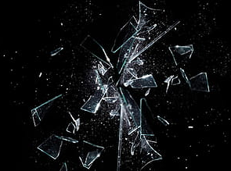
Our Fallen State
“Therefore, just as sin came into the world through one man, and death through sin, and so death spread to all men because all sinned…one trespass led to condemnation for all men... by the one man's disobedience the many were made sinners…” Romans 5:12,19
“Behold, I was brought forth in iniquity, and in sin did my mother conceive me. Psalm 51:5
“And you were dead in the trespasses and sins in which you once walked, following the course of this world…” Ephesians 2:1,2

Slide 9
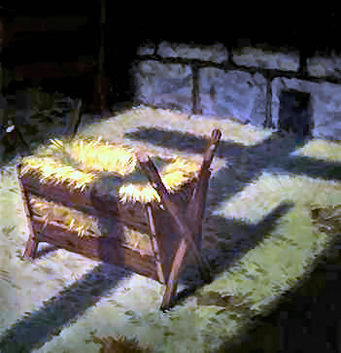
The Second Adam
“But when the fullness of time had come, God sent forth His Son, born of a woman, born under the law, to redeem those under the law…” Galatians 4:4,5
“Since therefore the children share in flesh and blood, He himself likewise partook of the same things, that through death He might destroy the one who has the power of death, that is, the devil, and deliver all those who through fear of death were subject to lifelong slavery... He had to be made like his brothers in every respect, so that He might become a merciful and faithful high priest in the service of God, to make propitiation for the sins of the people.” Hebrews 2:14-17

Slide 10
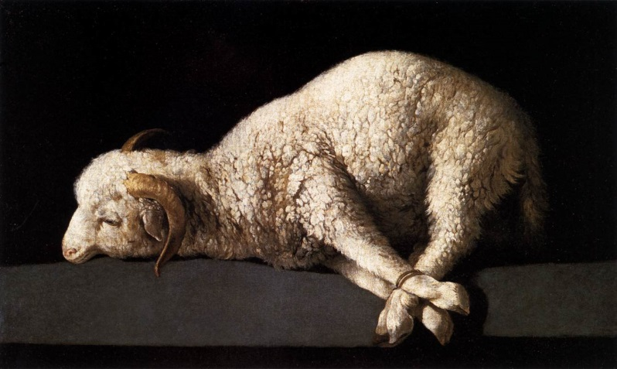
Penal Substitutionary Atonement
“But He was pierced for our transgressions; He was crushed for our iniquities; upon Him was the chastisement that brought us peace, and with his wounds we are healed. All we like sheep have gone astray; we have turned – every one – to his own way; and the Lord has laid on Him the iniquity of us all.” Isaiah 53:5,6
“For Christ, our Passover lamb, has been sacrificed.” I Cor. 5:7
“But now the righteousness of God has been manifested apart from the law… the righteousness of God through faith in Jesus Christ for all who believe… through the redemption that is in Christ Jesus, whom God put forward as a propitiation by his blood, to be received by faith.” Romans 3:21-25

Slide 11
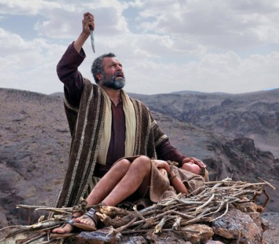
Propitiation
“You forgave the iniquity of Your people; You covered all their sin. You withdrew all Your wrath; You turned from your hot anger. Restore us again, O God of our salvation, and put away Your indignation toward us!” Psalm 85:2-4
“In this the love of God was made manifest among us, that God sent His only Son into the world, so that we might live through Him. In this is love, not that we have loved God but that He loved us and sent His Son to be the propitiation for our sins.” I John 4:9,10

Slide 12
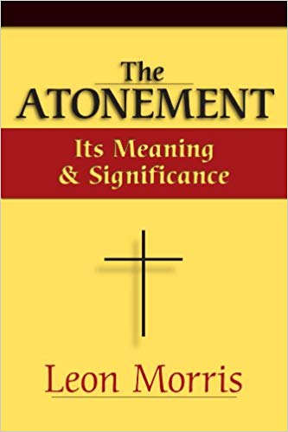
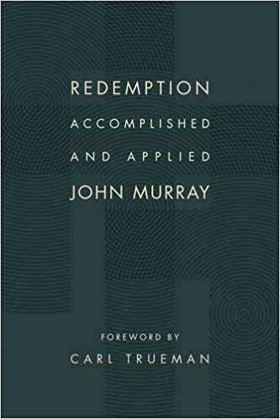
Propitiation
“God’s love is not a mindless sentimentality. It is a purifying fire, a force in the strongest opposition to everything that mars those whom God loves… The Bible is insistent that the wrath of God is the grim reality which the sinner must ultimately face… divine wrath is not the last word… [Christ] has made the offering that turns away wrath and as we put our trust in Him we need fear it no more.” Leon Morris
“…propitiation does not detract from the love and mercy of God; it rather enhances the marvel of His love. For it shows the cost that redemptive love entails.” John Murray

Slide 13
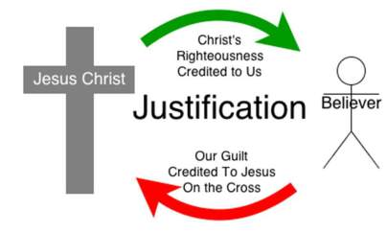
Imputation
“For what does the Scripture say? ‘Abraham believed God, and it was counted to him as righteousness.’” Romans 4:3
“Therefore, as one trespass led to condemnation for all men, so one act of righteousness leads to justification and life for all men. For as by the one man's disobedience the many were made sinners, so by the one man's obedience the many will be made righteous.” Romans 5:18,19
“For our sake He made Him to be sin who knew no sin, so that in Him we might become the righteousness of God.” II Corinthians 5:21

Slide 14
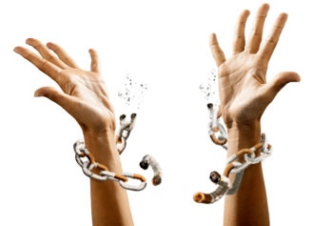
Died & Raised with Christ
“Do you not know that all of us who have been baptized into Christ Jesus were baptized into His death? We were buried therefore with Him by baptism into death, in order that, just as Christ was raised from the dead by the glory of the Father, we too might walk in newness of life… We know that our old self was crucified with Him in order that the body of sin might be brought to nothing, so that we would no longer be enslaved to sin. For one who has died has been set free from sin… So you also must consider yourselves dead to sin and alive to God in Christ Jesus.” Romans 6:3,4; 6,7; 11

Slide 15
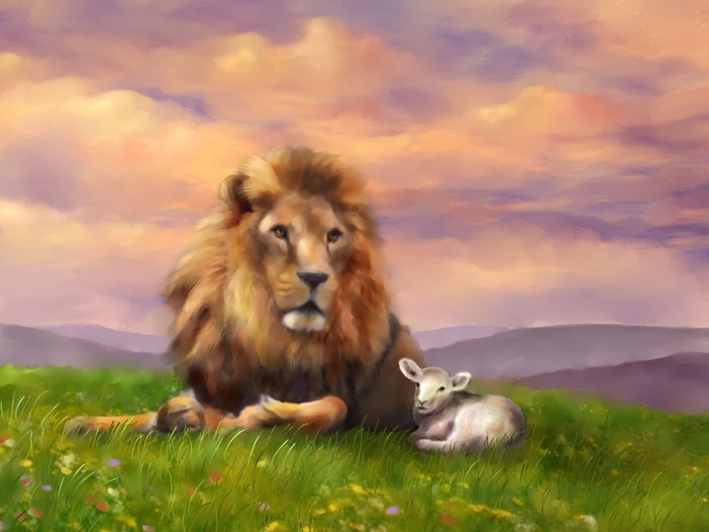
The Goal of Salvation
“For the creation was subjected to futility, not willingly, but because of Him who subjected it, in hope that the creation itself will be set free from its bondage to corruption and obtain the freedom of the glory of the children of God. For we know that the whole creation has been groaning together in the pains of childbirth until now. And not only the creation, but we ourselves, who have the firstfruits of the Spirit, groan inwardly as we wait eagerly for adoption as sons, the redemption of our bodies.” Romans 8:20-23

Slide 16
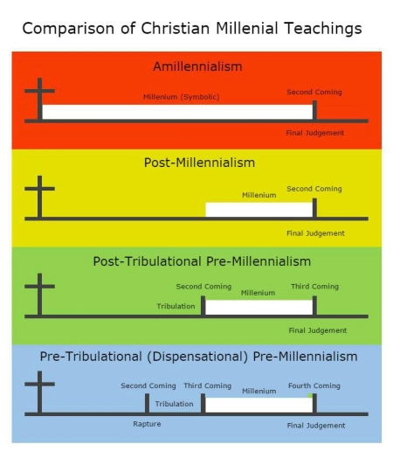
Eschatological Views

Slide 17
Satan Bound
“Then I saw an angel coming down from heaven, holding in his hand the key to the bottomless pit and a great chain. And he seized the dragon, that ancient serpent, who is the devil and Satan, and bound him for a thousand years, and threw him into the pit, and shut it and sealed it over him, so that he might not deceive the nations any longer, until the thousand years were ended. After that he must be released for a little while.” Revelation 20:1-3

Slide 18
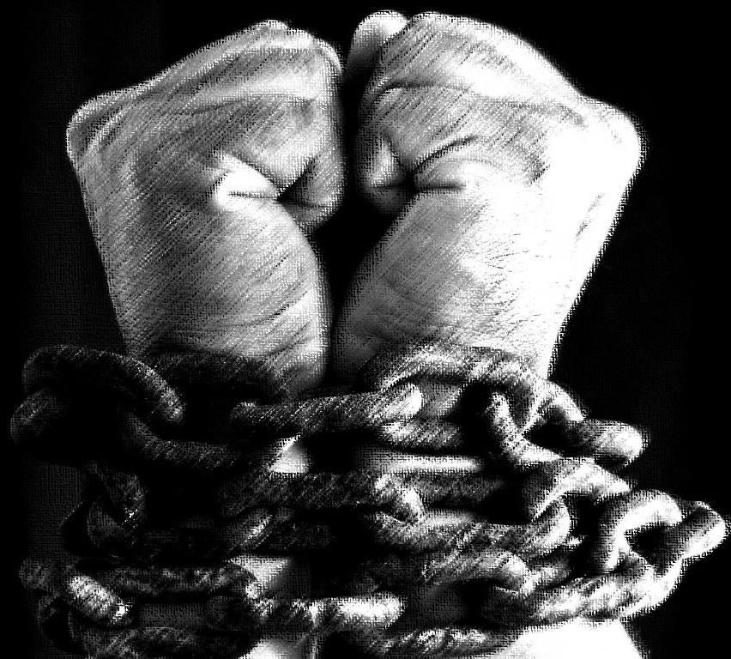
When Was Satan Bound?
“But if it is by the Spirit of God that I cast out demons, then the kingdom of God has come upon you. Or how can someone enter a strong man's house and plunder his goods, unless he first binds the strong man? Then indeed he may plunder his house.”
Matthew 12:28,29
“The seventy-two returned with joy, saying, ‘Lord, even the demons are subject to us in Your name!’ And He said to them, ‘I saw Satan fall like lightning from heaven. Behold, I have given you authority to tread on serpents and scorpions, and over all the power of the enemy…” Luke 10:17-19

Slide 19
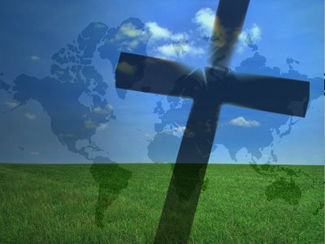
“Now is the judgment of this world; now will the ruler of this world be cast out. And I, when I am lifted up from the earth, will draw all people to Myself.” John 12:31,32
“Now war arose in heaven, Michael and his angels fighting against the dragon. And the dragon and his angels fought back, but he was defeated, and there was no longer any place for them in heaven. And the great dragon was thrown down, that ancient serpent, who is called the devil and Satan, the deceiver of the whole world – he was thrown down to the earth…” Revelation 12:7-9
“All authority in heaven and on earth has been given to Me. Go therefore and make disciples of all nations…” Matthew 28:18,19

